Slide 1
Cross-Examining Expert Witnesses
Gerald M. Jackson
Jackson County Prosecutor’s Office

Slide 2
AGENDA
Introduction
Preparation
The Cross
Summary

Slide 3
INTRODUCTION
An expert witness is primarily used to explain complex, scientific ideas to lay people.
Their perceived expertise can lend credibility to one side’s position, and a lot of people can put an expert on a pedestal.

Slide 4
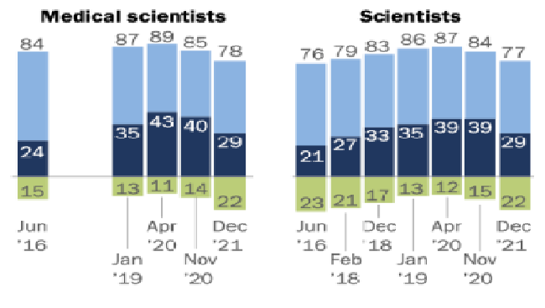
Changing trends
While the US population has typically had faith in institutions and experts, that faith has been waning in recent years.
-Experts are more open to criticism and skepticism than in recent memory.
% of U.S. Adults who have
confidence in the following groups
-Pew Research

Slide 5
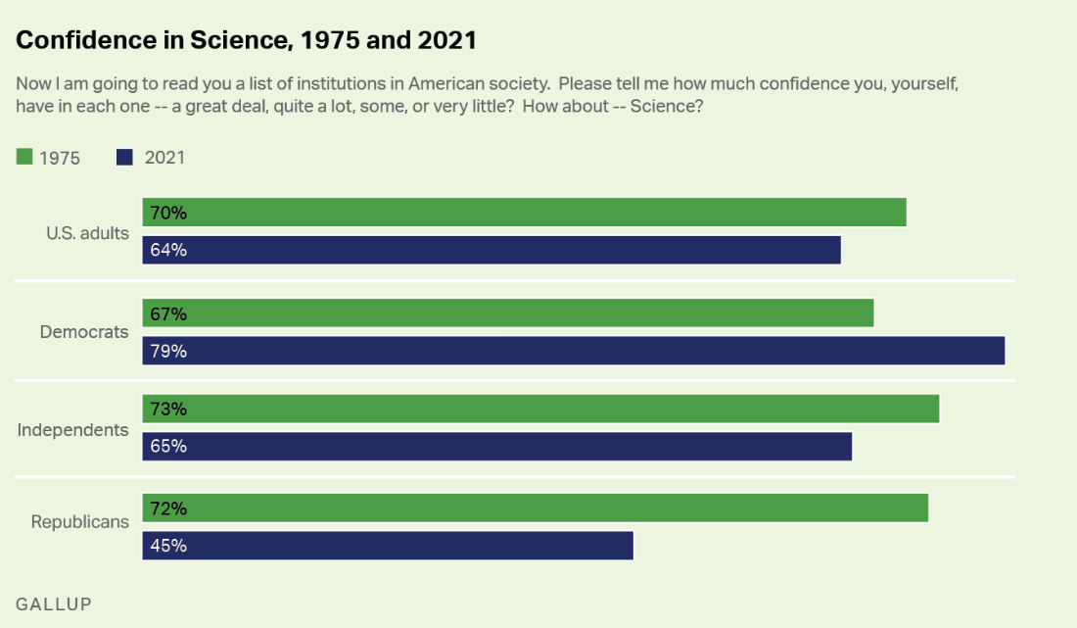
Changing Trends
This eroding of faith in science seems to express politically. Not only should you be cognizant of this when crafting your cross, its something that should be examined when crafting a voir dire.

Slide 6
Preparation
Where we win cases

Slide 7
Use Every avenue to gain knowledge
An effective cross-examination of an expert witnesses begins with pre-trial preparation:
Formal discovery responses
Expert reports
Informal investigations
Consultation with other experts in that field.
Pre-trial litigation (Daubert Motions)

Slide 8
Formal Discovery Responses / Expert Reports
Review the expert report
  Focus on any methodology
  Look for inconsistent application of any scientific principles
  See where the expert is drawing their standards
  If they’re accredited, see where the expert got their accreditation from
Review discovery responses
  documents that the expert reviewed (and possibly have your own expert review them)
  Summaries of their conclusions
  Rate of compensation

Slide 9
Informal Investigations
The internet and your own creativity is your friend
  Your expert will probably have a website or work for an organization with a website. REVIEW IT
    May find a mission statement
    May find other cases that they have been an expert in or consulted on
    May have other experiences that are omitted from their CV that may provide relevant information for cross-examination.
    Look for literature that they have published, op-eds they may have published, etc.
    Basically, scrub the net for their presence, see what they have omitted from their disclosure to you and look for contradictory opinions.
  Check professional registration records, see if there are any license disciplinary actions against them.

Slide 10
Consultation with Other Experts
- It’s always a good idea to have your own expert if there’s a complex scientific issue.
- Consulting with your own experts about an opposing expert may garner insights you would not be aware of on your own
- A lot of these fields are insular, and everyone has an opinion of each other. Explore that.
- Be sure to see if your expert can provide literature made in opposition to your opposing expert, or has knowledge that the standard they rely on is outdated or ineffective.

Slide 11
Daubert Motions
Test for admissibility:
(a) the evidence must amount to scientific or specialized technical knowledge that assists the trier of fact to understand or determine a fact in issue; (b) the testimony must be based on sufficient facts or data; (c) the testimony must be the product of reliable principles and methods; and (d) the proffered expert must reliably apply the scientific principals and methods to the facts of the case. RSMo. § 490.065.2(1); cf. Fed. R. Evid. 702, and K.S.A. 60-456
A Daubert Motion is an attempt to limit or exclude expert testimony.
It also give you an opportunity to present to opposing counsel and the court the weaknesses of an expert’s testimony which may be useful for future motions pre- and during trial.

Slide 12
Give yourself some time, don’t put it off because these issues are complex and require time to understand and craft.

Slide 13
The Cross

Slide 14
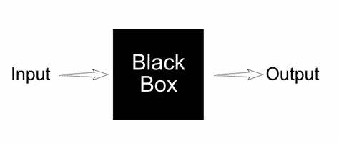
What are your goals?
Are we attacking the science (the black box) itself?
Are we attacking the input?
Are we attacking the observer of the output?
Do we only want to damage the conclusion but not the science?

Slide 15
What did you learn about your expert?
- If you conducted a deposition, how did they act when confronted with a tough question?
Did they frequently go on long diatribes?
Were they defensive?
How much of their conclusions were based on their subjective opinions
  If any part of their conclusions are subjective, then did you collect enough information to showcase any biases.
Do they come across as overly academic/pretentious?
What’s their standing in their field? Is the way they apply their science generally accepted in their field?

Slide 16
Areas to focus on
Qualifications and Credentials
How the expert came to their conclusions/opinion
The opinion itself
  (Unless the expert is completely deficient in all three, try and focus on one of these areas)

Slide 17
Some practical Tips
Keep it simple
Don’t get into arguments on the science (stick to the script)
Find areas of agreement when building the jury’s understanding of the subject matter.
They are professional witnesses. Avoid their strengths and giving them wiggle room to preach.
Point out assumptions that lead up to an ultimate opinion
If you have learned treatises and can lay foundation, they can be helpful in showing weaknesses in expert’s testimony (FRE 803(18)) (don’t base too much of your case on this as, especially in Kansas, there is a lot of pause to their admission. Wilson v. Knight, 26 Kan. App. 2d 226, 232 (1999))

Slide 18
More practical points
Point out financial in the case at hand, continued employment, prior testimony for this same party or attorney. This can include probing their total yearly income and how much this case makes up of that income, or their tendency to testify on behalf of this party or similar parties as an advocate-expert.
Don’t feel the need to drone on, an expert cross may be very quick if you have your own counter expert who will present better, if there is not much to adequately challenge, or if the scientific data isn’t the crux of the case.

Slide 19
Summary
Preparation is key, use every discovery tool and your creativity in investigation to pick apart their science and their history
Figure out what is weakest about their testimony: their actual science, their results, their science, or them. Prioritize which to attack and leave their strengths alone.
Keep calm and don’t argue, just keep things simple so the fact-finder can more easily see what doesn’t make sense.

Slide 20
THANK YOU
Gerald M. Jackson
gjackson@jacksongov.org

