Slide 1


Wyandotte County Bar Association
2022 LEGISLATIVE UPDATE
Presented by:
Joseph N. Molina III
September 21, 2022

Slide 2
Constitutional Amendments
Judicial Branch
BIDS
Bills of Interest
Elections
2022 Legislative Update

Slide 3
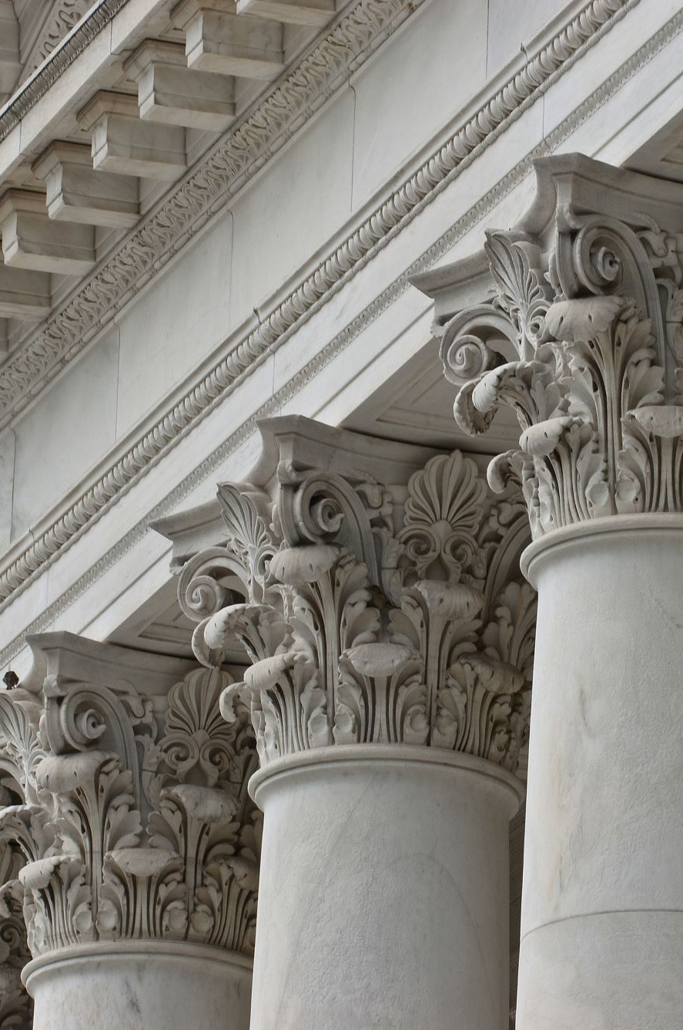
Judicial Branch
Office of Judicial Administration

Slide 4
Judicial Branch Budget
Website: https://www.kscourts.org/About-the-Courts/Court-Administration/Budget
FY 2022/FY 2023
HB 2541 – Docket Fee Transition to SGF

Slide 5
FY 2023 Request
Base Budget ($151 million)
Redirect docket fees to SGF
Sans surcharge fee
23 new judges (with Staff)
13 district and 10 magistrate
$5 million total request

Slide 6
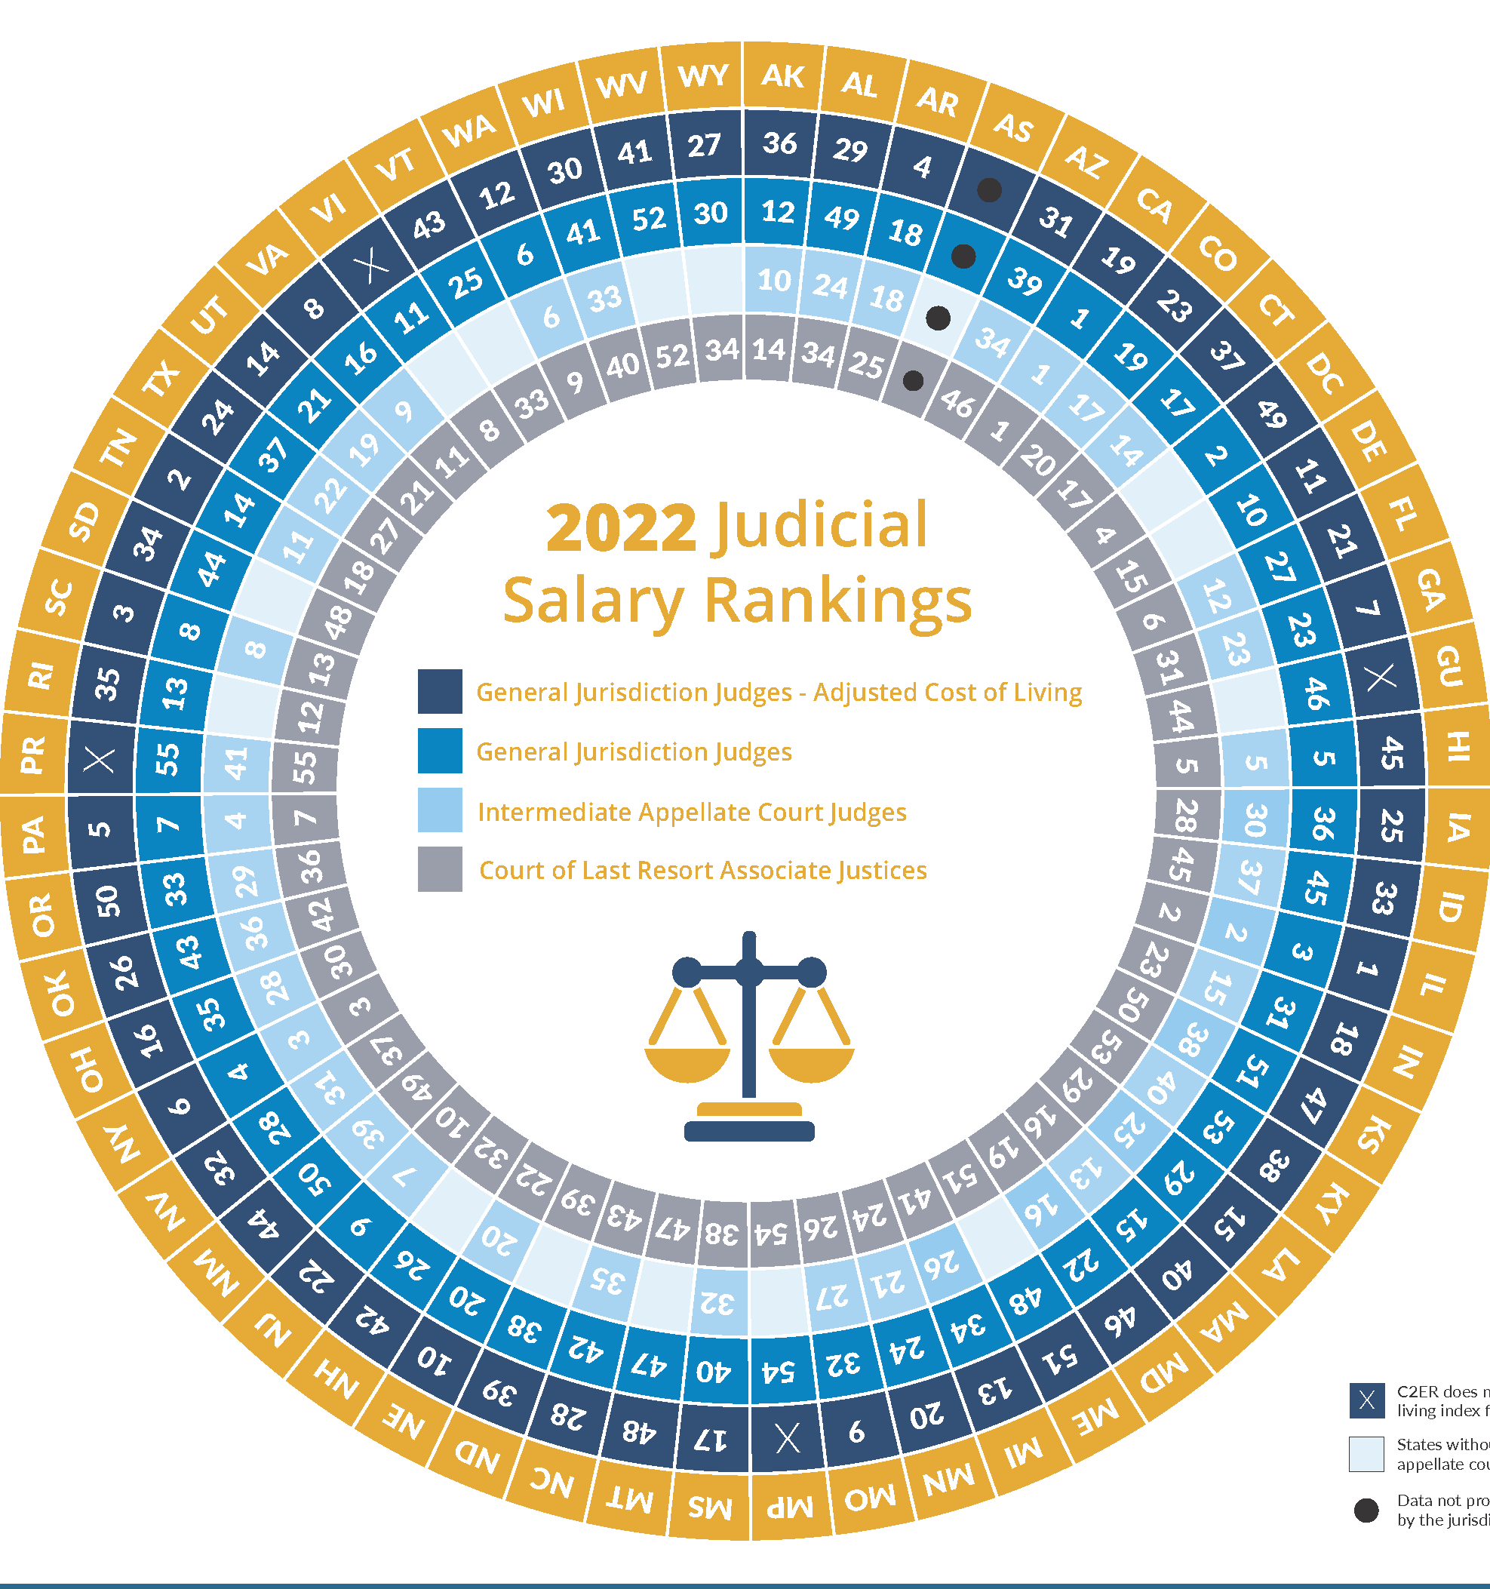
Survey of Judicial Salaries
Kansas MIssouri
$145,641 (50) $183,264 (27)
$140,940 (39) $167,535 (24)
$128,636 (51) $157,972 (32)
$131,355 (49) $175,623 (9)

Slide 7

Judicial Selection
SCR 1621 – Federal Model
SCR 1622 – Partisan Elections
HCR 5006 – Nominating Process COA

Slide 8
Kansas BIDS
$3.9 million for pay parity and employee pay scale adjustment
  Removed from 5% Cost of Living Adjustment
$3.6 million for assigned counsel rate increase - $100-$120 for FY 2023
  Provision for assigned counsel rate increase – HB 2363 not approved
$316,000 for technical upgrades and additional office space
  Funding for WyCo office will be in 2023 request

Slide 9
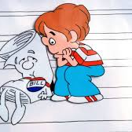
BILLS
Conference Committee Reports
Litigation
Probate/Real Estate
Family

Slide 10
Judiciary CCR
CCR for HB 2299 Law Enforcement Bundle
CCR for HB 2277 Criminal Law Bundle
CCR for HB 2377 DUI Bundle
CCR for HB 2109 Records Bundle

Slide 11

Litigation
SB 150 Advertising
SB 151 CAPS
SB 152 Third Party Financing
SB 286 COVID-19 response
SB 2458 Optometrist/Ophthalmologist

Slide 12

Real Estate,
Probate & Trusts
SB 141 Uniform Directed Trust Act
Sub for SB 400 Uniform Trust Code
HB 2025 Copy of Will
SB 382 License requirement for real estate transactions
HB 2531 Right of Way along county roads

Slide 13

Family Law
HB 2496 Uniform Family Law Arbitration Act
HB 2725 Shared Parenting
SB 575 Presumptive Joint Legal Custody
HB 2153 Office of the Child Advocate
HB 2075 Adoption Venue
CCR for SB 343 Hearing impairment and legal custody

Slide 14
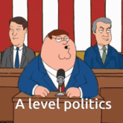
2022
Primary Elections
https://ent.sos.ks.gov/kssos_ent.html

Slide 15
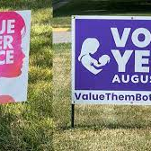
HCR 5003 – Value Them Both
Constitutional Amendment “YES” = 378,466 (41%)
Constitutional Amendment
“NO” = 543,855 (59%)
Total votes – 922,321
Margin – 165,389

Slide 16
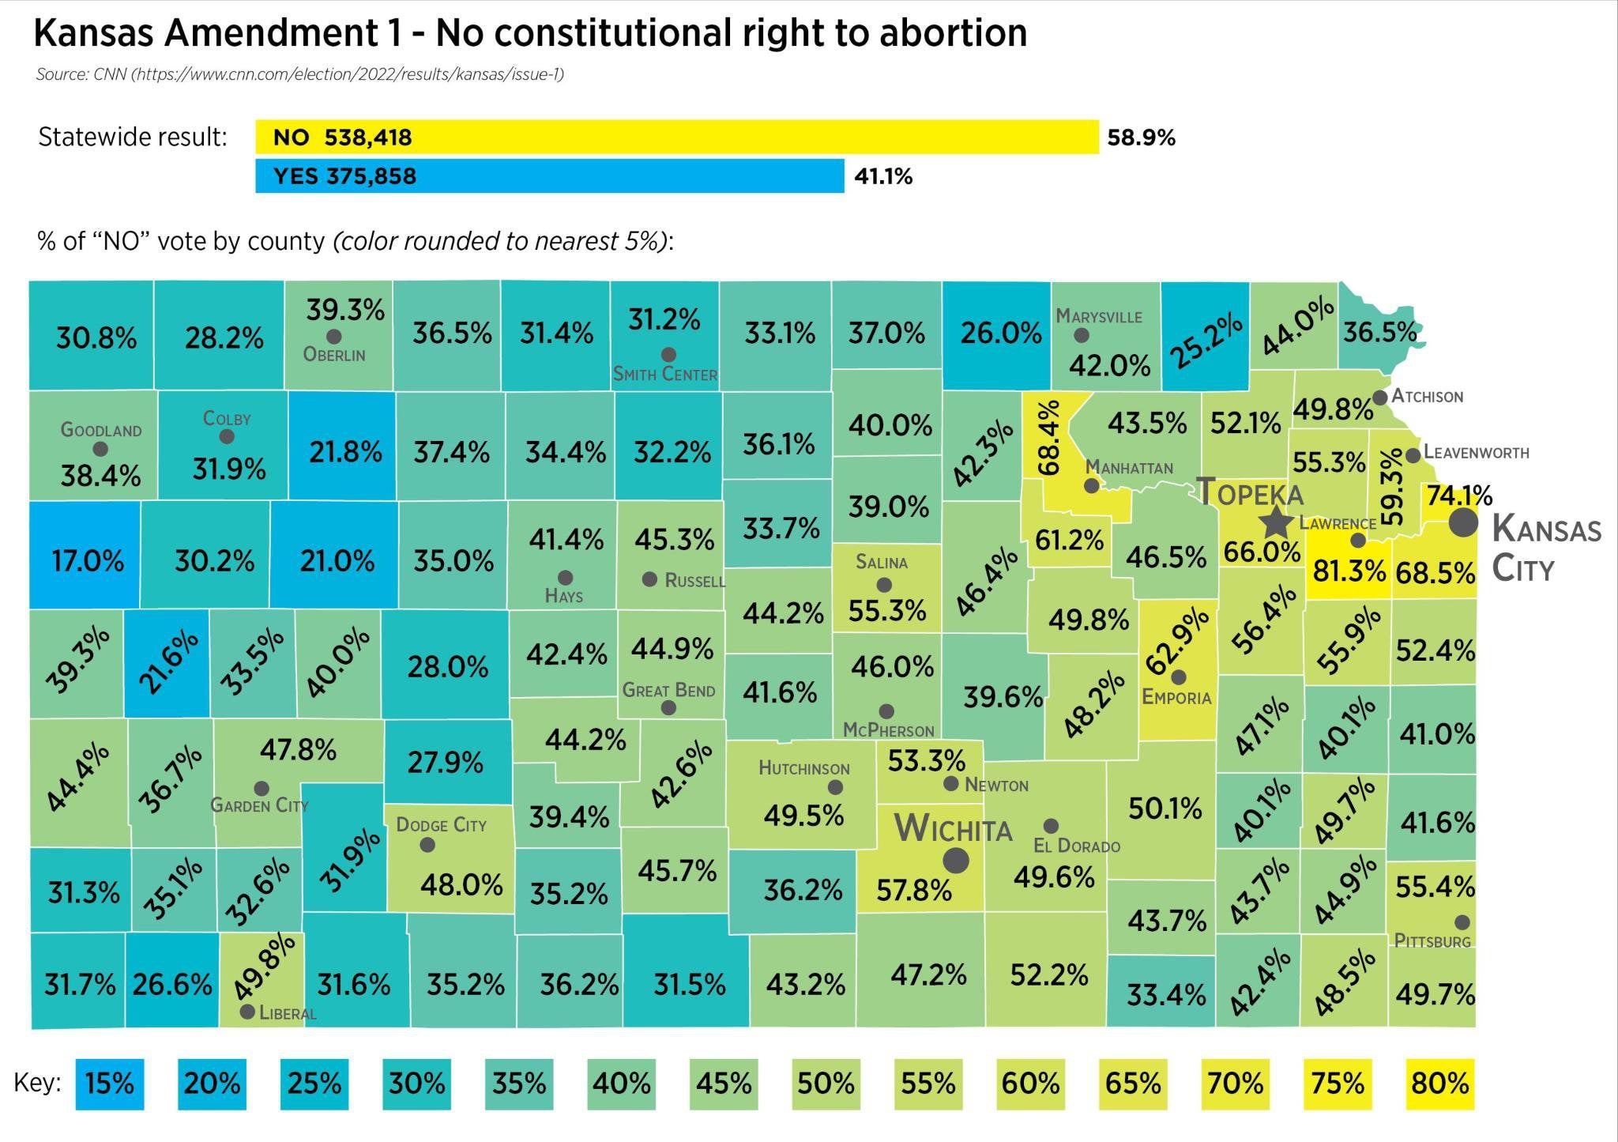
HCR 5003 -Breakdown
Ford County–YES 74%/No 25%

Slide 17
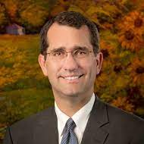
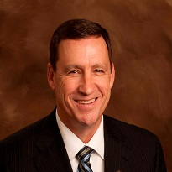
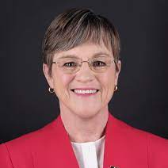
Kansas Governor Race
Incumbent Gov. Laura Kelly (D)
Republican Nominee KS AG Derek Schmidt (R)
Kansas State Senator Dennis Pyle (I)
Total Primary votes = 783,073

Slide 18
Third Party Candidates
General Elections
Governor’s Race 2014
Governor’s Race 2018
Brownback – 433,196 (49.8%)
Paul Davis – 401,100 (46.1%)
Keen Umbehr – 35,206 (4.0%)
Laura Kelly – 506,509 (48.03%)
Kris Kobach – 453,030 (42.96%)
Greg Orman – 68,498 (6.50%)

Slide 19
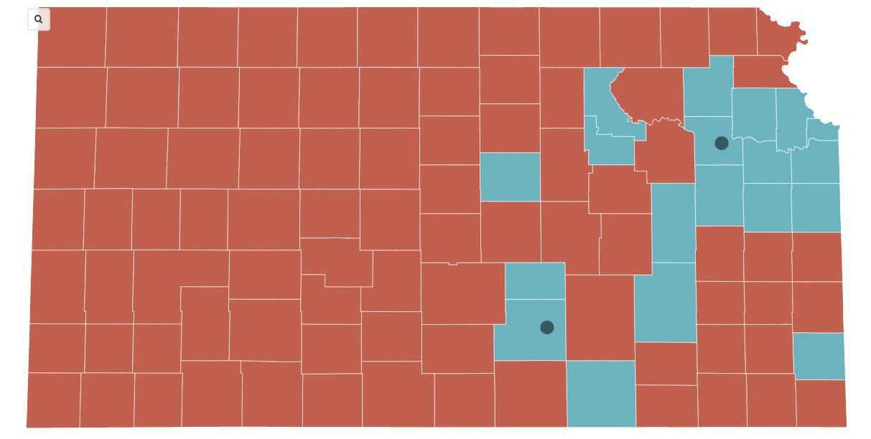
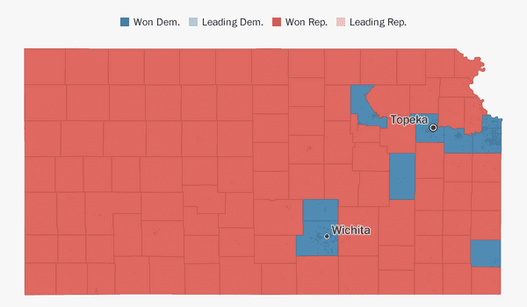
HCR 5003 possible impact on GOV race
HCR 5003 County Results
2018 Gubernatorial County Results

Slide 20
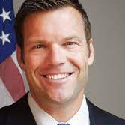
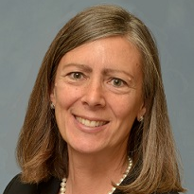
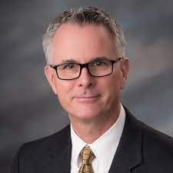
Kansas Attorney General Race
Republican Primary
Kris Kobach – 197,576 (42%)
Kellie Warren – 177,564 (38%)
Tony Mattivi – 62,651 (20%)

Slide 21
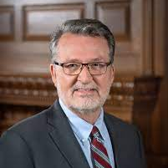
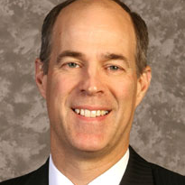
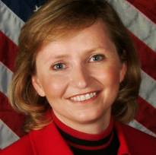
Kansas State Treasure
Lynn Rogers Democrat Incumbent Treasurer
Steven Johnson Republican – 215,875 (50%)
Caryn Tyson Republican – 215,500 (50%)

Slide 22
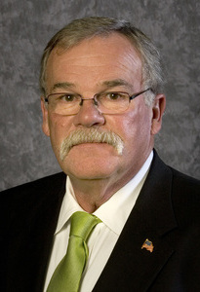
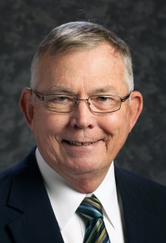
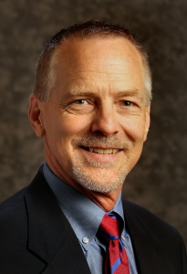
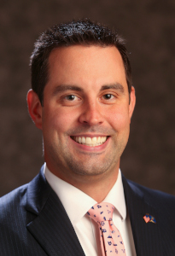
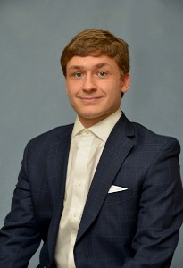
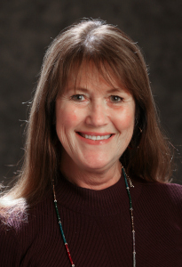
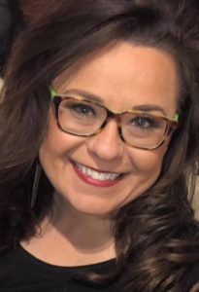
Primary Shake UP

Slide 23
Dominos
Speaker of the House Ron Ryckman (R- Olathe)
Speaker Pro Tem Blaine Finch (R-Ottawa)
Rep. Jim Kelly (R-Independence)
Rep. Steve Huebert (R-Valley Center)
Rep. Lonnie Clark (R-Junction City)
Rep. David French (R-Lansing)
Rep. Tom Burroughs (D-Kansas City)
Rep. Kathy Wolfe Moore (D-Kansas City)
Rep. Jim Gartner (D-Topeka)

Slide 24
Constitutional Amendments
HCR 5014 – Rules and Regs (Senate 27-12; House 85-39) General Election
HCR 5022 – Election of Sheriff (Senate 36-2; House 97-24) Primary Election

Slide 25
Legislative Resources
Kansas Legislature www.kslegislature.org/li
Kansas Leg. Research
http://www.kslegresearch.org/KLRD-web/Policy.html
State of Kansas:
www.kansas.gov
Office of the Governor:
www.ksgovernor.org
Judicial Branch:
www.kscourts.org

