Slide 1
THE LAWYER DISCIPLINE PROCESS
Wyandotte county bar association
June 23, 2022
James L. Spies

Slide 2
Road Map
Disciplinary Authority
Complaints
Investigations
Diversion
Review Committee
Hearing Panel
Supreme Court

Slide 3
Board of Discipline
John D. Gatz, Chair
Derrick L. Roberson, Vice Chair
Gregory L. Bauer
Stephen W. Cavanaugh
Jeffrey A. Chubb
Shaye L. Downing
John M. Duma
Rebecca Faurot
Thomas Hammond, II
Glen I. Kerbs
John E. Larson
Terry L. Mann
Kathryn J. Marsh
Mira Mdivani
Stacy L. Ortega
James P. Rankin
Lee M. Smithyman
Kala Spigarelli
Gaye Tibbets
Darcy D. Williamson
Notes:
Start with looking at WHO specifically is vested with the authority to discipline my license?
Board of Discipline –
All licensed attorneys (no public members)* Lawyers govern lawyers. I believe that we need to get the regulation right, or else we risk having it taken away.
Number of Board Members: 20
How Appointed: Appointed by the Kansas Supreme Court
Term Length: 4 years (can be reappointed for 3 terms = cap at total of 12 years)
About:
Judicial Branch- Arm of the Supreme Court (Not an administrative agency – but similarities exist in the procedures)
What is the Board’s role/function?
Serve on the Review Committee and Hearing Panels
**Can impose informal admonishment and recommend diversion – all other discipline is recommendations only to the Supreme Court
Cases are not presented to the Board as a Whole, but rather a Panel of (3) Board Members.

Slide 4
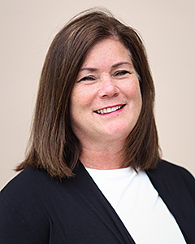
Office of the Disciplinary Administrator
Gayle Larkin
Notes:
There is also the staff who investigate and “prosecute” ethics complaints:
Disciplinary Administrator – Gayle Larkin (Serves at the pleasure of the Kansas Supreme Court)
Deputy Disciplinary Administrators (7)
Admissions Attorney / Counsel to the Board of Discipline (1): Gayle Larkin’s replacement
Investigators (3): Currently one is a KS licensed attorney and two have law enforcement background

Slide 5
Disciplinary Authority
To investigate allegations of lawyer misconduct and make recommendations to the Supreme Court for discipline when warranted.
  Rule 201 Definitions “Misconduct” – an act or omission that violates the KRPCs, Rules Relating to Discipline of Attorneys, or the attorney’s oath of office.
  The office does NOT settle fee disputes
  The office does NOT recover funds for client
Notes:
Do we really need regulation of the practice of law?
Disciplinary proceedings are as much for the protection of the profession as the public. Instills public confidence.
*It is a privilege to practice law; not a right.
*A lawyer must be fit to be entrusted with legal matters as an officer of the court.
What lawyers?
(Rule 201)
Any attorney who holds a bar card
Any attorney specially admitted by a court (Pro Hac Vice)
State v. Scott, 230 Kan. 564 (1982);
State v. Callahan, 232 Kan. 136 (1982)
What constitutes “misconduct”?
Conjures up thoughts of lying, cheating and stealing involving clients. “Misconduct” may be broader than you initially think.
(2) And Lawyer misconduct can occur even in you personal life when “off duty.”

Slide 6
Self Reporting
  Rule 209(b): 30 days = Report lapse / cancellation / termination of insurance
  Rule 219(c): Report criminal charge or indictment to disciplinary administrator no later than 14 days after charge filed.
  Rule 219(d) & 219(e): 14 days = Attorney and clerk of court report criminal conviction
  Rule 221: 14 days notify the disciplinary administrator in writing after another jurisdiction disciplines an attorney or refers an attorney to the attorney diversion program or comparable program

Slide 7
Statistics FY 2019
(July 1, 2018 - June 30, 2019)
Total Complaints Received
849
Complaints Docketed
193
Total No. Disciplined
79
Hearing Panel
13
Cases to Supreme Court-31
Notes:
Dismissed No Discipline (93%)
-- Summarily after informal response and
-- By review committee for those complaints docketed
Only a small percentage of complaints received go to a Hearing Panel and then the Kansas Supreme Court

Slide 8

Notes:
Who is filing the complaints?
These statistics are not required to be kept, so this is the most current year.
Who files –
Clients (*attorney-client relationship NOT prerequisite for
filing a complaint – State v. Freeman, 229 Kan. 639 (1981)).
Other attorneys– Rules 207(c), 226, and 270
Disciplinary Administrator (i.e. learns of a criminal conviction)
Self-report – Rule 207(c) (violations and/or discipline in another jurisdiction)
State v. Phelps, 226 Kan. 371 (1979)
State v. Russell, 227 Kan. 897 (1980)
State v. Freeman, 229 Kan. 639 (1981)
Judges – Rule 207(d) and Judicial Canon 2, Rule 15(B), (D)
Miscellaneous others

Slide 9
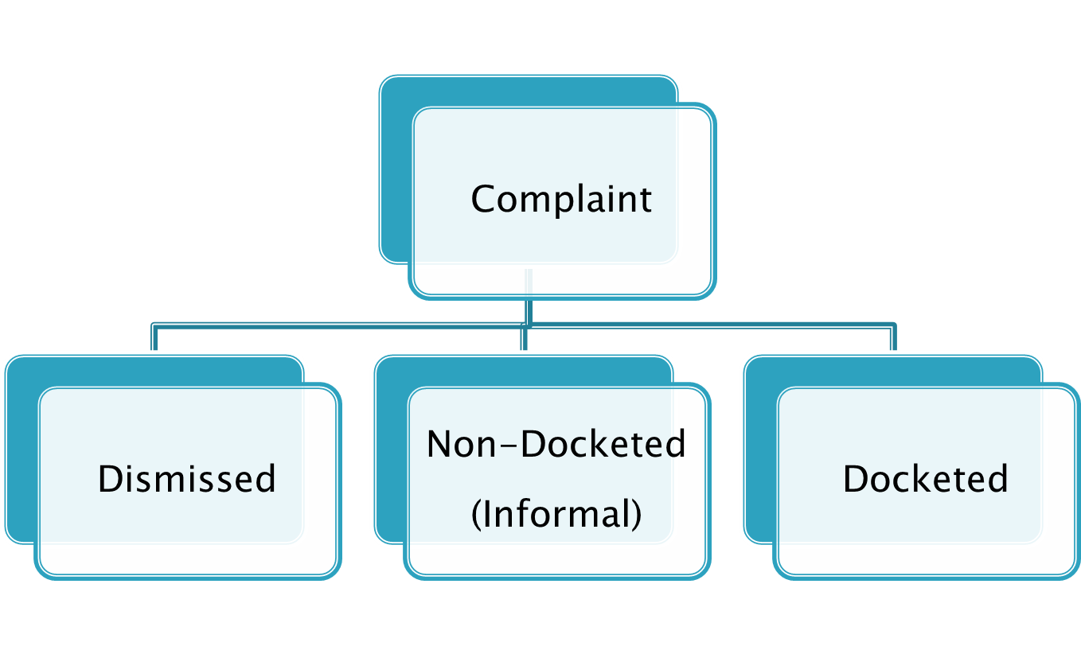
Triaging Complaints
Kansas Supreme Court Rules 201- 207 – govern processing complaints
Form of Submission (Rule 209) Written complaint form is online at kscourts.org
Notes:
-Oral complaints – listen to individual. Phone call to attorney. Resolve if possible, then no further action. For complaint to be processed further it must be in writing.
Dismissed
When its frivolous on the face, its fails to allege any violation, or is not within the office’s jurisdiction. The respondent attorney may never know of the complaint at all. (Pros/Cons)
Non-docketed (Informal) (Rule 209)
Complaints where it is questionable whether a violation exists may be explored before assigning a docket number. Attorney’s side obtained by letter. Attorney should fully respond. Opportunity to resolve complaint without the matter being docketed. Complaint will be dismissed if determined by Deputy Attorney (Kate Baird) to be meritless.
Docketed
Docketed for investigation (any time misconduct is alleged)
The complaint is given a case number and sent to the attorney for a response.
Attorney notified of diversion program

Slide 10
Benefits of A Complaint Not Docketed
  A shorter response is often sufficient
  No formal investigation, interviews of witnesses,
  production of file
  Dismissal without Review Committee so more
  expedient
  More private (Less Reputational Risk)

Slide 11
Duty to Cooperate
Written Response Required. Duty to cooperate and failure is a violation in itself. Rule 207.
The office has disciplined individuals for failing to respond to complaints that otherwise wouldn’t have been a matter of concern.
In the Matter of Cole, 268 Kan. 828 (2000) (Court indefinitely suspended the respondent for failure to cooperate in the disciplinary investigation despite the fact the underlying complaint appeared to lack merit.)

Slide 12
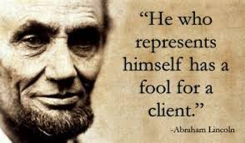
Responding To Complaints
Notes:
-Don’t let embarrassment prevent you or a colleague from seeking out assistance – internally within your law firm or external with retained legal counsel. Malpractice insurer may have a provision to provide regulatory defense services.
-It may seem tempting to just handle the matter quietly yourself……but that may not be the best tactic. I have had clients who tried that and when the Review Committee found probable cause, then we were able to go back and have them take a second look resulting in different findings.
Respondent Attorney may have tunnel vision regarding the case since they are vested emotionally – a new perspective can be advantageous.

Slide 13
Tips For Responding To Complaints
  The ODA is flexible in extending time to respond.
  The Attorney’s response may be attached to the formal complaint.
  Accept your mistakes.
  Clear violations warrant consideration of diversion.
  Take measures to proactively mitigate matter.
  For a docketed complaint – submit more than a bare response.
  Provide supporting documents.

Slide 14

Investigations
If there is something amiss with trust funds, the Disciplinary Administrator can issue subpoenas for trust and operating accounts.
Investigator interviews Complainant and gathers all relevant documentary evidence.
Investigator interviews all other relevant witnesses.
Investigator interviews responding attorney.
Supreme Court Rules 205, 207, 210 and 223
Notes:
-- In-house OR
-- Ethics & Grievance Committees (Rule 210(b)): Assist with the investigations of complaint
Investigations are confidential –
Investigative Reports:
- Find facts and list
- Conclusions
- Review and consider KRPC
Which rules violated?
Can violation be proven by clear & convincing evidence?
Practical Tip 1: Most Investigators are fair and reasonable in their approach and deference.
Practical Tip #2: Ask if they have any unresolved concerns and the opportunity to further address them.
Practical Tip #3: Ask for a copy of the investigative report. Try to obtain before the matter is presented to the Review Committee as the report may influence whether you submit a written request for diversion.

Slide 15
Diversion
Diversion Program:
  Alternative to disciplinary action
  Participation is a privilege; not a right
  No prior disciplinary history.
  Not for violations involving dishonesty or theft
  Goal is to protect the public by improving the professional competency, education, and rehabilitation of members of the bar
Notes:
The Responding attorney is notified regarding diversion at the same time they are notified of the complaint.
Supreme Court Rule -- Diversion must be requested prior to the Review Committee considering the case.
(3) The investigator makes a recommendation regarding the request for diversion and whether attorney suitable for diversion considering these factors:
-nature of the violation
-duty violated
-whether harm result to the client
-respondent’s self reporting the misconduct
-respondent’s remedial action
-any mitigating circumstances
-any aggravating circumstances
-whether diversion will be effective at deterring repeat violations
(4) Review Committee reviews investigation and determines whether to offer diversion. Equivalent to a finding under Supreme Court Rule 210(c) that there is probable cause to believe that the Respondent has violated the Kansas Rules of Professional Conduct. That finding remains confidential if the diversion is successfully completed. (Rule 226)
(5) Some Attorney Respondents who would qualify don’t request it so the investigator and assigned Deputy Disciplinary Administrator will discuss program with Respondent. There is always an exception to the rule. However, once the case proceeds to a hearing, then diversion is off the table.

Slide 16
Review Committee
Members:
2 Board Members
1 Attorney At Large
Meetings:
Continuously address cases through email, but
meet in person quarterly as well.
Function:
To determine if probable cause exists for a
violation.
Notes:
Rules 204(e) and 210(c):
DA prepares a “Rule 204 Report” to the Review Committee summarizing and analyzing the allegations, investigations, etc. It is attorney-work product not discoverable.
The Respondent Attorney does not participate in these proceedings.
Practical Tip 1: The Review Committee may depart from the investigator’s conclusions.
Practical Tip 2: You may wish to provide additional information to the Review Committee after their initial look. But you do so potentially at your own peril.

Slide 17
Review Committee
If The Committee Recommends:
  Dismissal
  Diversion Recommendation OR
  Informal Admonishment
Then the case ends at this stage.
Any other discipline and formal proceedings go forward.
Notes:
Informal Admonishment – Attorney can reject and request a Panel Hearing **but why??

Slide 18
Formal Complaint
  The ODA serves Formal Complaint
      Rule 224(a) 14 days after the Formal Complaint the ODA serves a witness list for the panel hearing
  Attorney Response within 21 days (Rule 215(b))
      Rule 224(b) 14 days after Answer to formal complaint Respondent to file and serve witness list
Notes:
-Witnesses ALWAYS: Complainant, investigator and Respondent (unless facts are stipulated to)
-Exhibits ALWAYS: Complaint, Response, Most of the Documents acquired during investigation (but NOT usually the investigator’s report)

Slide 19
Discovery Procedure
    Scheduling conference
    Witness & exhibit lists
    Expert designations
    Rebuttal experts
    Subpoenas
    Depositions
Notes:
Blank Page because there is no Discovery.
-generally not permitted (Rule 222(d))
- No written discovery like in civil matters
- ODA has an “open file” policy
- No discovery depositions general rule – exceptions to be made.

Slide 20
Prehearing Deadlines
  Rule 224(c): 21 days after formal complaint = Any party designate expert witness including report or summary of opinions.
        21 days after designation = Designate rebuttal expert including report or summary of opinions.
  Rule 223(c): Parties submit agreement for summary submission of case to hearing panel no later than 30 days before hearing.
  Rules 216(a), 227(a), 217(b)(4): 14 days before hearing = File motions, plan for probation, motion to quash subpoena.
        7 days before hearing response/opposition to motions
Notes:
Agreement for Summary Submission – Discuss in Depth Next Slide

Slide 21
Summary Submission
New Procedure (Rule 223)
Agreement of parties
Submit case directly to Supreme Court foregoing Panel Hearing
Stipulation:
Respondent admits the misconduct as alleged
Contents of the record
Findings of fact and conclusions of law, including violations of rules or oath
Recommendation for discipline
Waiver of a panel hearing
No exception to the findings / conclusions will be filed
Board may approve or disapprove
If not approve = panel hearing
If approve = straight to court
Notes:
Why would an attorney do this?
Save some costs that would ultimately be imposed?
Avoid the emotional, financial, and time burdens associated with the panel hearing
Why wouldn’t an attorney do this?
You don’t get the full benefit of the Panel Hearing showing sympathy towards any existing mitigating facts
Don’t accept all of the allegations in the Formal Complaint

Slide 22
Securing Witnesses’ Appearances
  30 days before the hearing = respondent must request (Disciplinary administrator may issue subpoenas)
  21 days before the hearing = subpoena must be served
      Mileage, travel and meals = paid by the party requesting the subpoena
  14 days before hearing = file motion requesting witness to appear by video or phone

Slide 23
Panel Hearing
  Open to the public
  Witnesses
  Cross-examination
  Initial finding of violation
  Presentation of evidence of aggravation and mitigation
  Panel deliberation
  Report
Notes:
Evidence - Rules of Evidence Apply (Rule 211(d)).
Arguments- “Trial briefs” and proposed findings and conclusions are not allowed unless specifically requested by the panel.
Burden of proof: clear and convincing evidence. “Evidence that causes the factfinder to believe that “the truth of the facts asserted is highly probably.” In re Lober, 288 Kan. 498, 505 (2009).
Recommendations – The Panel takes matter under advisement and deliberate immediately following conclusion of hearing but it must prepare a report setting out findings of fact, conclusions of law, recommendations, mitigating and aggravating factors considered.

Slide 24
Disciplinary Actions
Rule 203- Types of Discipline. The Panel may recommend:
  No violation and dismissal of complaint. ODA can appeal this to the Supreme Court
  Informal Admonishment – Case Ends
  Pubic Censure – Goes to Supreme Court
  Probation – Goes to Supreme Court
  Suspension– Goes to Supreme Court
  Disbarment (Rule 217) – Goes to Supreme Court
  Any other discipline deemed appropriate
Notes:
*Surrender – shall be treated as a disbarment; In re Sparks, 242 Kan. 11 (1987)
**NOTE NO FINE AUTHORITY** Administrative Agencies usually will have authority to fine a licensed professional for minor infractions, but it is not a tool in the Disciplinary Administrator’s tool box.
American Bar Association Standards for Imposing Attorney Discipline - Given great weight
-aggravating factors
- Mitigating factors

Slide 25
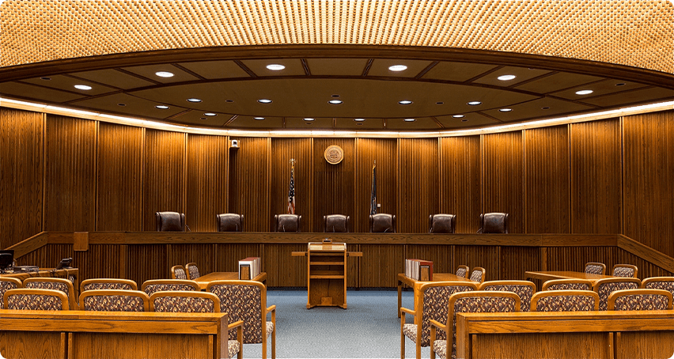
Kansas Supreme Court Oral Arguments
Notes:
Oral arguments
Respondent is REQUIRED to appear
If there is a violation other than diversion or informal admonishment there is no way to quietly settle the matter.
Video recorded and archived
Weight of the Hearing Panel Report
-Advisory only, BUT gives same dignity as a special verdict by a jury or findings of a trial court
Published decisions – importance of keeping abreast of the decisions
Kansas Bar Association summaries opinions in weekly newsletter

Slide 26
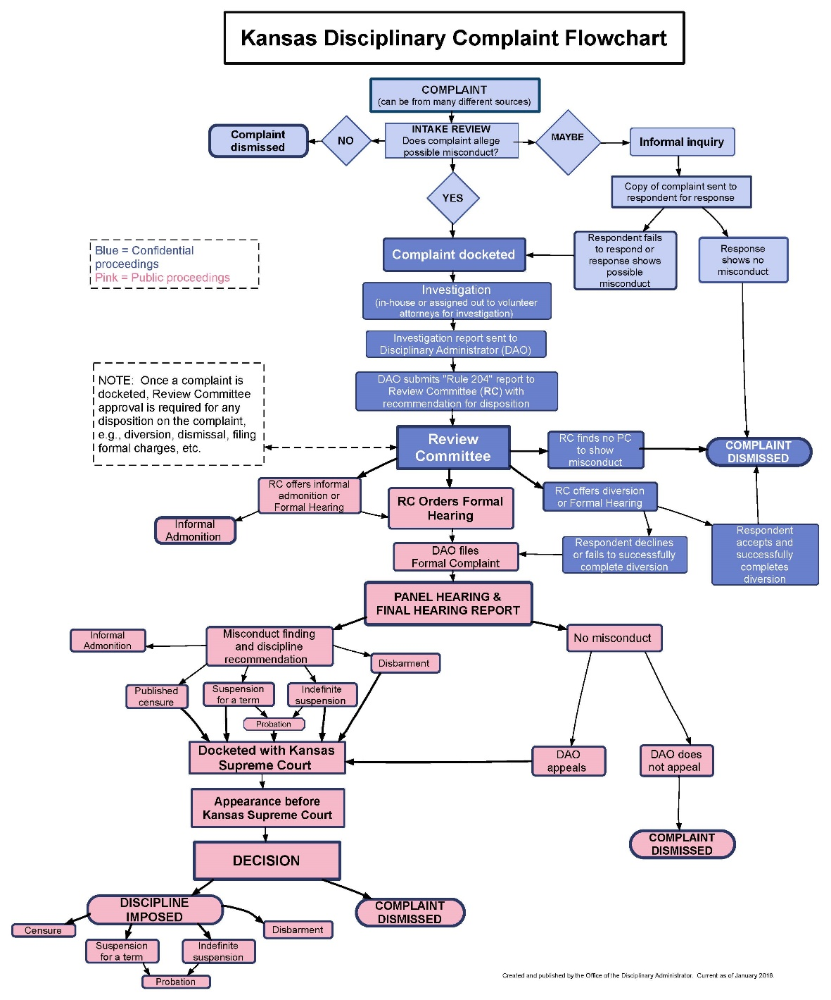

Slide 27
SPECIAL NOTE OF THANKS
TO THE OFFICE OF DISCIPLINARY ADMINISTRATOR STAFF
FOR PROVIDING INFORMATION USED IN THIS PRESENTATION

