Slide 1

5th ANNUAL BENCH-BAR trial advocacy seminar
May 20, 2022
Jennifer tatum
Assistant prosecuting attorney
Jackson county prosecutor’s office

Slide 2
AGENDA
1. DISCUSS APPLICABLE EXPERT WITNESS STATUTES AND LEGAL AUTHORITY
2. DISCUSS ETHICAL RULES REGARDING EXPERT TESTIMONY
3. DISCUSS DISCOVERY OBLIGATIONS REGARDING EXPERT WITNESSES
4. HOW TO SELECT AND PRESENT AN EXPERT AT TRIAL
5. A LITTLE TRIVIA
6. Q and As

Slide 3
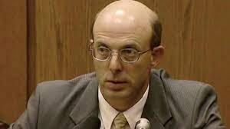
NAME THAT EXPERT…

Slide 4
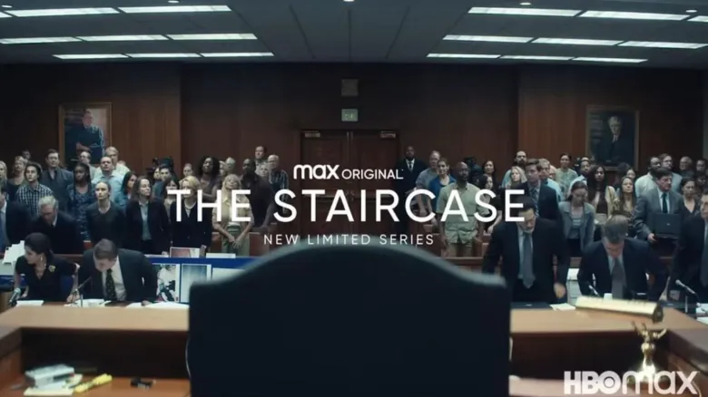
DUANE DEVER
STATE OF N. CAROLINA v. MICHEAL PETERSON

Slide 5
k.s.a 60-456
(b) If scientific, technical or other specialized knowledge will help the trier of fact to understand the evidence or to determine a fact in issue, a witness who is qualified as an expert by knowledge, skill, experience, training or education may testify thereto in the form of an opinion or otherwise if: (1) The testimony is based on sufficient facts or data; (2) the testimony is the product of reliable principles and methods; and (3) the witness has reliably applied the principles and methods to the facts of the case.
(c) Unless the judge excludes the testimony, the judge shall be deemed to have made the finding requisite to its admission.
(d) Testimony in the form of opinions or inferences otherwise admissible under this article is not objectionable because it embraces the ultimate issue or issues to be decided by the trier of the fact.

Slide 6
MO REV. STAT. 490.065
1. In actions brought under chapter 451, 452, 453, 454, or 455 or in actions adjudicated in juvenile courts under chapter 211 or in family courts under chapter 487, or in all proceedings before the probate division of the circuit court, or in all actions or proceedings in which there is no right to a jury trial:
(1) If scientific, technical or other specialized knowledge will assist the trier of fact to understand the evidence or to determine a fact in issue, a witness qualified as an expert by knowledge, skill, experience, training, or education may testify thereto in the form of an opinion or otherwise;
(2) Testimony by such an expert witness in the form of an opinion or inference otherwise admissible is not objectionable because it embraces an ultimate issue to be decided by the trier of fact;
(3) The facts or data in a particular case upon which an expert bases an opinion or inference may be those perceived by or made known to him at or before the hearing and must be of a type reasonably relied upon by experts in the field in forming opinions or inferences upon the subject and must be otherwise reasonably reliable;
(4) If a reasonable foundation is laid, an expert may testify in terms of opinion or inference and give the reasons therefor without the use of hypothetical questions, unless the court believes the use of a hypothetical question will make the expert's opinion more understandable or of greater assistance to the jury due to the particular facts of the case.

Slide 7
MO. REV. STAT. 490.065
2. In all actions except those to which subsection 1 of this section applies:
(1) A witness who is qualified as an expert by knowledge, skill, experience, training, or education may testify in the form of an opinion or otherwise if:
(a) The expert's scientific, technical, or other specialized knowledge will help the trier of fact to understand the evidence or to determine a fact in issue;
(b) The testimony is based on sufficient facts or data;
(c) The testimony is the product of reliable principles and methods; and
(d) The expert has reliably applied the principles and methods to the facts of the case;

Slide 8
MO. REV. STAT. 490.065
(2) An expert may base an opinion on facts or data in the case that the expert has been made aware of or personally observed. If experts in the particular field would reasonably rely on those kinds of facts or data in forming an opinion on the subject, they need not be admissible for the opinion to be admitted. But if the facts or data would otherwise be inadmissible, the proponent of the opinion may disclose them to the jury only if their probative value in helping the jury evaluate the opinion substantially outweighs their prejudicial effect;
(3)(a) An opinion is not objectionable just because it embraces an ultimate issue.
(b) In a criminal case, an expert witness shall not state an opinion about whether the defendant did or did not have a mental state or condition that constitutes an element of the crime charged or of a defense. Those matters are for the trier of fact alone;
(4) Unless the court orders otherwise, an expert may state an opinion and give the reasons for it without first testifying to the underlying facts or data. But the expert may be required to disclose those facts or data on cross-examination.

Slide 9
FED RULE OF EVIDENCE 702
A witness who is qualified as an expert by knowledge, skill, experience, training, or education may testify in the form of an opinion or otherwise if:
(a) the expert's scientific, technical, or other specialized knowledge will help the trier of fact to understand the evidence or to determine a fact in issue;
(b) the testimony is based on sufficient facts or data;
(c) the testimony is the product of reliable principles and methods; and
(d) the expert has reliably applied the principles and methods to the facts of the case.

Slide 10
FeD rule of evidence rule 703
An expert may base an opinion on facts or data in the case that the expert has been made aware of or personally observed. If experts in the particular field would reasonably rely on those kinds of facts or data in forming an opinion on the subject, they need not be admissible for the opinion to be admitted. But if the facts or data would otherwise be inadmissible, the proponent of the opinion may disclose them to the jury only if their probative value in helping the jury evaluate the opinion substantially outweighs their prejudicial effect.

Slide 11
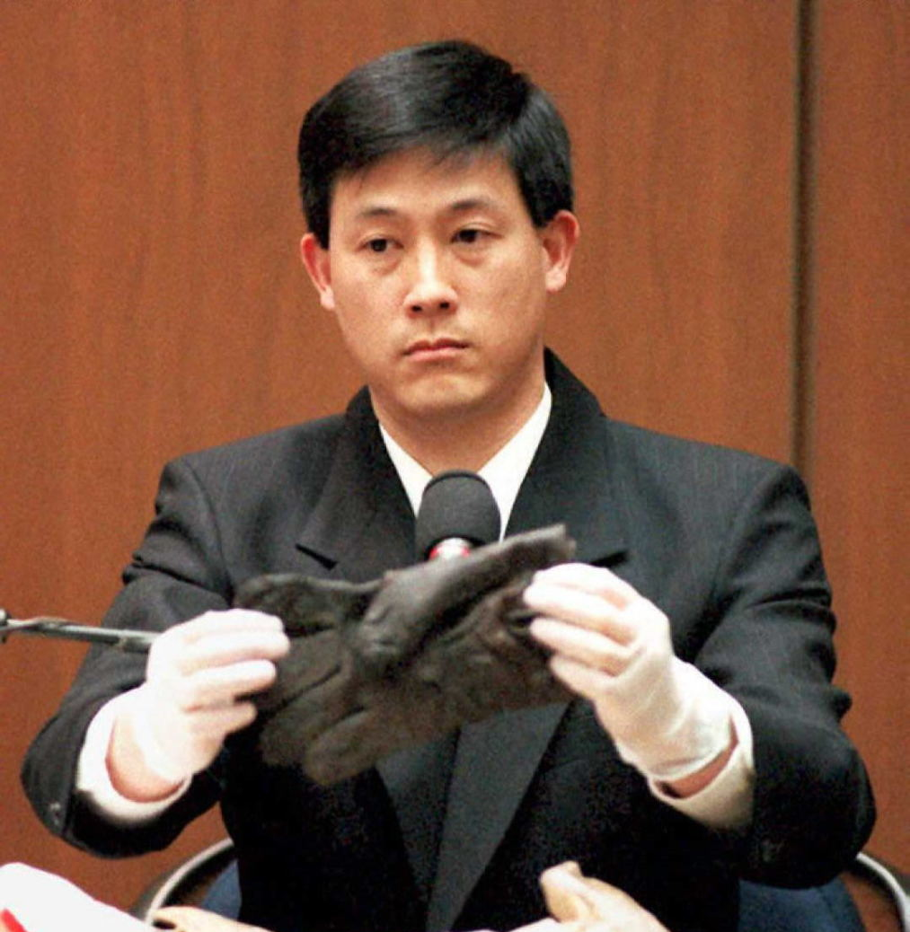
NAME THAT EXPERT…

Slide 12
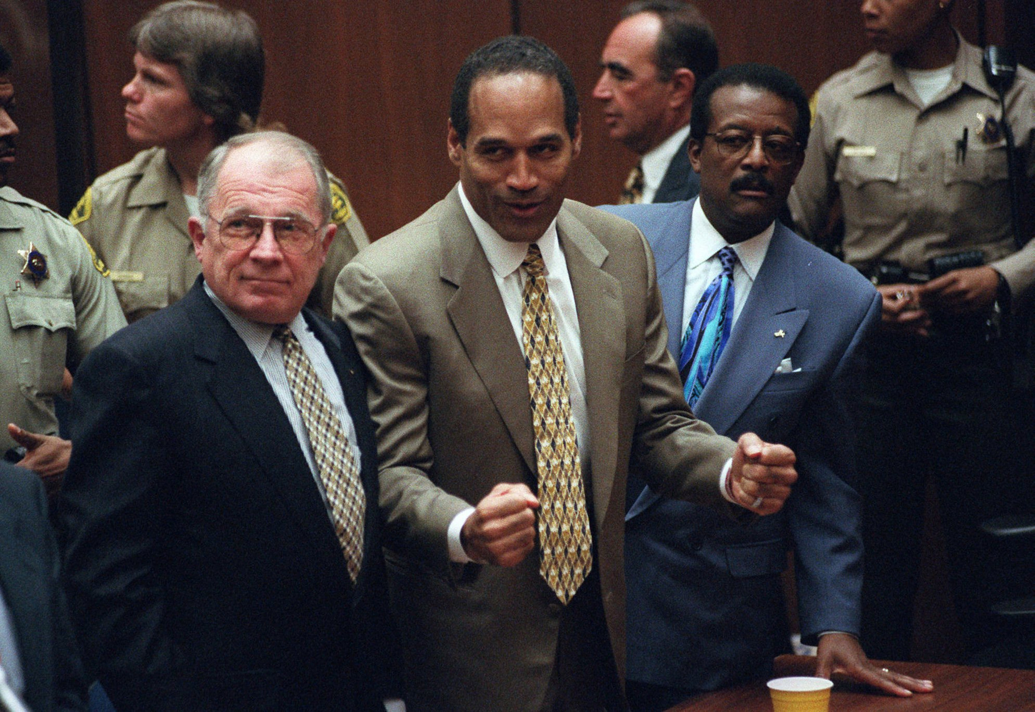
DENNIS FUNG
The People of the State of California v. Orenthal James Simpson

Slide 13
DAUBERT v. MERRELL PHARMACEUTICALS INC.
113 S. Ct. 2786 ( 1993)
(1) whether the expert's technique or theory can be or has been tested---that is, whether the expert's theory can be challenged in some objective sense, or whether it is instead simply a subjective, conclusory approach that cannot reasonably be assessed for reliability; (2) whether the technique or theory has been subject to peer review and publication; (3) the known or potential rate of error of the technique or theory when applied; (4) the existence and maintenance of standards and controls; and (5) whether the technique or theory has been generally accepted in the scientific community
NOT EXCLUSIVE

Slide 14
QUIZ? WHAT DRUG WAS AT ISSUE In DAUBERT
BENDECTON- PERSCRIPTION ANTINAUSEA DRUG

Slide 15
OTHER CONSIDERATIONS…
(4) Whether the expert “is being as careful as he would be in his regular professional work outside his paid litigation consulting.” Sheehan v. Daily Racing Form, Inc., 104 F.3d 940, 942 (7th Cir. 1997). See Kumho Tire Co. v. Carmichael, 119 S.Ct. 1167, 1176 (1999) (Daubert requires the trial court to assure itself that the expert “employs in the courtroom the same level of intellectual rigor that characterizes the practice of an expert in the relevant field”).
(5) Whether the field of expertise claimed by the expert is known to reach reliable results for the type of opinion the expert would give. See Kumho Tire Co. v. Carmichael, 119 S.Ct.1167, 1175 (1999) (Daubert's general acceptance factor does not “help show that an expert's testimony is reliable where the discipline itself lacks reliability, as for example, do theories grounded in any so-called generally accepted principles of astrology or necromancy.”), Moore v. Ashland Chemical, Inc., 151 F.3d 269 (5th Cir. 1998) (en banc) (clinical doctor was properly precluded from testifying to the toxicological cause of the plaintiff's respiratory problem, where the opinion was not sufficiently grounded in scientific methodology); Sterling v. Velsicol Chem. Corp., 855 F.2d 1188 (6th Cir. 1988) (rejecting testimony based on “clinical ecology” as unfounded and unreliable).

Slide 16
OTHER CONSIDERATIONS..
(1) Whether experts are “proposing to testify about matters growing naturally and directly out of research they have conducted independent of the litigation, or whether they have developed their opinions expressly for purposes of testifying.” Daubert v. Merrell Dow Pharmaceuticals, Inc., 43 F.3d 1311, 1317 (9th Cir. 1995).
(2) Whether the expert has unjustifiably extrapolated from an accepted premise to an unfounded conclusion. See General Elec. Co. v. Joiner, 522 U.S. 136, 146 (1997) (noting that in some cases a trial court “may conclude that there is simply too great an analytical gap between the data and the opinion proffered”).
(3) Whether the expert has adequately accounted for obvious alternative explanations. See Claar v. Burlington N.R.R., 29 F.3d 499 (9th Cir. 1994) (testimony excluded where the expert failed to consider other obvious causes for the plaintiff's condition). Compare Ambrosini v. Labarraque, 101 F.3d 129 (D.C. Cir. 1996) (the possibility of some uneliminated causes presents a question of weight, so long as the most obvious causes have been considered and reasonably ruled out by the expert).

Slide 17
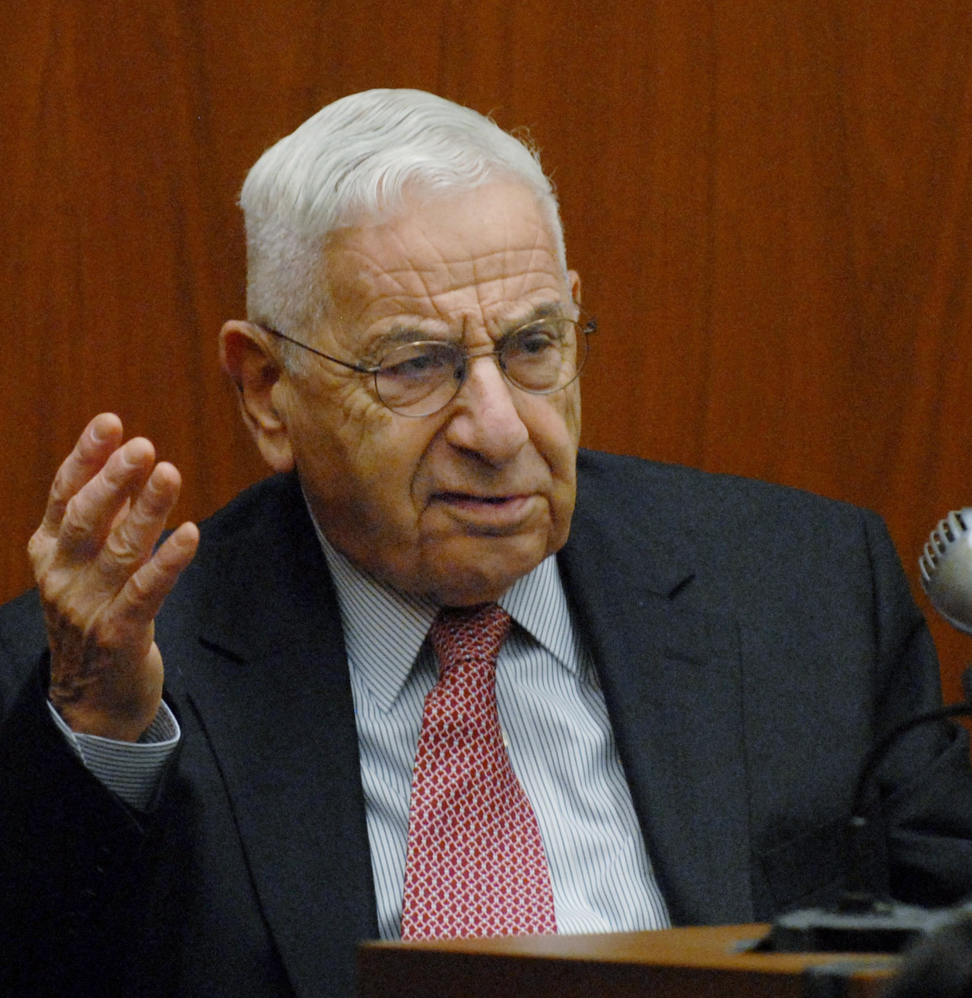
NAME THAT EXPERT …

Slide 18
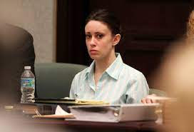
DR. WERNER SPITZ
STATE OF FLORIDA V. CASEY MARIE ANTHONY

Slide 19
ABA RULE 3.1
A lawyer shall not bring or defend a proceeding, or assert or controvert an issue therein, unless there is a basis in law and fact for doing so that is not frivolous, which includes a good faith argument for an extension, modification or reversal of existing law. A lawyer for the defendant in a criminal proceeding, or the respondent in a proceeding that could result in incarceration, may nevertheless so defend the proceeding as to require that every element of the case be established.

Slide 20
ABA RULE 3.3
(a) A lawyer shall not knowingly:
(3) offer evidence that the lawyer knows to be false. If a lawyer, the lawyer’s client, or a witness called by the lawyer, has offered material evidence and the lawyer comes to know of its falsity, the lawyer shall take reasonable remedial measures, including, if necessary, disclosure to the tribunal. A lawyer may refuse to offer evidence, other than the testimony of a defendant in a criminal matter, that the lawyer reasonably believes is false.

Slide 21
ABA RULE 3.4
A lawyer shall not:
(b) falsify evidence, counsel or assist a witness to testify falsely, or offer an inducement to a witness that is prohibited by law;

Slide 22
EXAMPLE
Numatics Inc. v. Balluff Inc. and Barnum Company (13-11049), the court excluded the testimony of an expert retained by defense counsel based on the fact that the expert's report was written by counsel.

Slide 23
ABA RULE 1.6
(a) A lawyer shall not reveal information relating to the representation of a client unless the client gives informed consent, the disclosure is impliedly authorized in order to carry out the representation or the disclosure is permitted by paragraph (b).
PARAGRAPH B DOES NOT SPEAK TO THIS

Slide 24
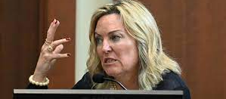
NAME THAT EXPERT..

Slide 25
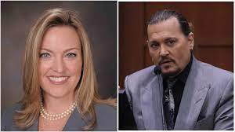
Dr. DAWN HUGHES
JOHNNY DEPP v. AMBER HEARD

Slide 26
K.S.A. 60-226
(a) Discovery methods. Parties may obtain discovery by one or more of the following methods: Depositions on oral examination or written questions; written interrogatories; production of documents or things or permission to enter onto land or other property under K.S.A. 60-234, K.S.A. 60-245(a)(1)(A)(iii) or K.S.A. 60-245a, and amendments thereto; physical and mental examinations; and requests for admission.
(b) Discovery scope and limits. (1) Scope in general. Unless otherwise limited by court order, the scope of discovery is as follows: Parties may obtain discovery regarding any nonprivileged matter that is relevant to any party's claim or defense and proportional to the needs of the case, considering the importance of the issues at stake in the action, the amount in controversy, the parties' relative access to relevant information, the parties' resources, the importance of the discovery in resolving the issues and whether the burden or expense of the proposed discovery outweighs its likely benefit. Information within this scope of discovery need not be admissible in evidence to be discoverable.

Slide 27
K.S.A. 60-226
(5) Trial preparation; experts.
(A) Deposition of an expert who may testify. A party may depose any person who has been identified as an expert whose opinions may be presented at trial. If a disclosure is required under subsection (b)(6), the deposition may be conducted only after the disclosure is provided.
(B) Trial-preparation protection for draft disclosures. Subsections (b)(4)(A) and (b)(4)(B) protect drafts of any disclosure required under subsection (b)(6), and drafts of a disclosure by an expert witness provided in lieu of the disclosure required by subsection (b)(6), regardless of the form in which the draft is recorded.
(C) Trial-preparation protection for communications between a party's attorney and expert witnesses. Subsections (b)(4)(A) and (b)(4)(B) protect communications between the party's attorney and any witness about whom disclosure is required under subsection (b)(6), regardless of the form of the communications, except to the extent that the communications:
(i) Relate to compensation for the expert's study or testimony;
(ii) identify facts or data that the party's attorney provided and that the expert considered in forming the opinions to be expressed; or
(iii) identify assumptions that the party's attorney provided and that the expert relied on in forming the opinions to be expressed.
(D) Expert employed only for trial preparation. Ordinarily, a party may not, by interrogatories or deposition, discover facts known or opinions held by an expert who has been retained or specially employed by another party in anticipation of litigation or to prepare for trial and who is not expected to be called as a witness at trial. But a party may do so only:
(i) As provided in K.S.A. 60-235(b), and amendments thereto; or
(ii) on showing exceptional circumstances under which it is impracticable for the party to obtain facts or opinions on the same subject by other means.

Slide 28
K.S.A. 60-226
(D) Expert employed only for trial preparation. Ordinarily, a party may not, by interrogatories or deposition, discover facts known or opinions held by an expert who has been retained or specially employed by another party in anticipation of litigation or to prepare for trial and who is not expected to be called as a witness at trial. But a party may do so only:
(i) As provided in K.S.A. 60-235(b), and amendments thereto; or
(ii) on showing exceptional circumstances under which it is impracticable for the party to obtain facts or opinions on the same subject by other means.
(E) Payment. Unless manifest injustice would result, the court must require that the party seeking discovery:
(i) Pay the expert a reasonable fee for time spent in responding to discovery under subsection (b)(5)(A) or (b)(5)(D); and
(ii) for discovery under subsection (b)(5)(D), also pay the other party a fair portion of the fees and expenses it reasonably incurred in obtaining the expert's facts and opinions.
Kan. Stat. Ann. § 60-226 (West)

Slide 29
K.S.A. 60-266
(D) Expert employed only for trial preparation. Ordinarily, a party may not, by interrogatories or deposition, discover facts known or opinions held by an expert who has been retained or specially employed by another party in anticipation of litigation or to prepare for trial and who is not expected to be called as a witness at trial. But a party may do so only:
(i) As provided in K.S.A. 60-235(b), and amendments thereto; or
(ii) on showing exceptional circumstances under which it is impracticable for the party to obtain facts or opinions on the same subject by other means.
(E) Payment. Unless manifest injustice would result, the court must require that the party seeking discovery:
(i) Pay the expert a reasonable fee for time spent in responding to discovery under subsection (b)(5)(A) or (b)(5)(D); and
(ii) for discovery under subsection (b)(5)(D), also pay the other party a fair portion of the fees and expenses it reasonably incurred in obtaining the expert's facts and opinions.

Slide 30
K.S.A. 60-266
(2) Expert witness. For an expert to whom the disclosure requirement in subsection (b)(6) applies, the party's duty to supplement extends both to information included in the disclosure and to information given during the expert's deposition. Any additions or changes to this information must be disclosed at least 30 days before trial, unless the court orders otherwise.
SEE ALSO K.S.A. 22-3212 for criminal cases

Slide 31
Mo. Sup. Ct. rule 56.01
(b) Scope of Discovery. Unless otherwise limited by order of the court in accordance with these rules, the scope of discovery is as follows:
(1) In General. Parties may obtain discovery regarding any matter, not privileged, that is relevant to the subject matter involved in the pending action, whether it relates to the claim or defense of the party seeking discovery or to the claim or defense of any other party, including the existence, description, nature, custody, condition and location of any books, documents, or other tangible things and the identity and location of persons having knowledge of any discoverable matter, provided the discovery is proportional to the needs of the case considering the totality of the circumstances, including but not limited to, the importance of the issues at stake in the action, the amount in controversy, the parties' relative access to relevant information, the parties' resources, the importance of the discovery in resolving the issues, and whether the burden or expenses of the proposed discovery outweighs its likely benefit.
Information within the scope of discovery need not be admissible in evidence to be discoverable if the information sought appears reasonably calculated to lead to the discovery of admissible evidence.
The party seeking discovery shall bear the burden of establishing relevance.

Slide 32
Mo. SUP. CT. RULE 56.01
(6) Trial Preparation: Experts. Discovery of facts known and opinions held by experts, otherwise discoverable under the provisions of Rule 56.01(b)(1) and acquired or developed in anticipation of litigation or for trial, may be obtained only as follows:
(A) A party may require through interrogatories, any other party to identify each person whom the other party expects to call as an expert witness at trial by providing such expert's name, address, occupation, place of employment, and qualifications to give an opinion or, if such information is available on the expert's curriculum vitae, such curriculum vitae may be attached to the interrogatory answers as a full response to such interrogatory, and to state the general nature of the subject matter on which the expert is expected to testify and the expert's hourly deposition fee.
(B) A party may discover by deposition the facts and opinions to which the expert is expected to testify. Unless manifest injustice would result, the court shall require that the party seeking discovery from an expert pay the expert a reasonable hourly fee for the time such expert is deposed.

Slide 33
Mo. SUP. CT. RULE 56.01
(7) Trial Preparation: Non-retained Experts. A party, through interrogatories, may require any other party to identify each non-retained expert witness, including a party, whom the other party expects to call at trial who may provide expert witness opinion testimony by providing the expert's name, address, and field of expertise. For the purpose of this Rule 56.01(b)(7), an expert witness is a witness qualified as an expert by knowledge, experience, training, or education giving testimony relative to scientific, technical, or other specialized knowledge that will assist the trier of fact to understand the evidence. Discovery of the facts known and opinions held by such an expert shall be discoverable in the same manner as for lay witnesses.

Slide 34
See also rule 25.03 for criminal cases

Slide 35
FED RULE 26
(A) In General. In addition to the disclosures required by Rule 26(a)(1), a party must disclose to the other parties the identity of any witness it may use at trial to present evidence under Federal Rule of Evidence 702, 703, or 705.
(B) Witnesses Who Must Provide a Written Report. Unless otherwise stipulated or ordered by the court, this disclosure must be accompanied by a written report—prepared and signed by the witness—if the witness is one retained or specially employed to provide expert testimony in the case or one whose duties as the party's employee regularly involve giving expert testimony. The report must contain:
(i) a complete statement of all opinions the witness will express and the basis and reasons for them;
(ii) the facts or data considered by the witness in forming them;
(iii) any exhibits that will be used to summarize or support them;
(iv) the witness's qualifications, including a list of all publications authored in the previous 10 years;
(v) a list of all other cases in which, during the previous 4 years, the witness testified as an expert at trial or by deposition; and
(vi) a statement of the compensation to be paid for the study and testimony in the case.

Slide 36
FED RULE 26
(C) Witnesses Who Do Not Provide a Written Report. Unless otherwise stipulated or ordered by the court, if the witness is not required to provide a written report, this disclosure must state:
(i) the subject matter on which the witness is expected to present evidence under Federal Rule of Evidence 702, 703, or 705; and
(ii) a summary of the facts and opinions to which the witness is expected to testify.
(D) Time to Disclose Expert Testimony. A party must make these disclosures at the times and in the sequence that the court orders. Absent a stipulation or a court order, the disclosures must be made:
(i) at least 90 days before the date set for trial or for the case to be ready for trial; or
(ii) if the evidence is intended solely to contradict or rebut evidence on the same subject matter identified by another party under Rule 26(a)(2)(B) or (C), within 30 days after the other party's disclosure.

Slide 37
FED RULE 26
(4) Trial Preparation: Experts.
(A) Deposition of an Expert Who May Testify. A party may depose any person who has been identified as an expert whose opinions may be presented at trial. If Rule 26(a)(2)(B) requires a report from the expert, the deposition may be conducted only after the report is provided.
(B) Trial-Preparation Protection for Draft Reports or Disclosures. Rules 26(b)(3)(A) and (B) protect drafts of any report or disclosure required under Rule 26(a)(2), regardless of the form in which the draft is recorded.
(C) Trial-Preparation Protection for Communications Between a Party's Attorney and Expert Witnesses. Rules 26(b)(3)(A) and (B) protect communications between the party's attorney and any witness required to provide a report under Rule 26(a)(2)(B), regardless of the form of the communications, except to the extent that the communications:
(i) relate to compensation for the expert's study or testimony;
(ii) identify facts or data that the party's attorney provided and that the expert considered in forming the opinions to be expressed; or
(iii) identify assumptions that the party's attorney provided and that the expert relied on in forming the opinions to be expressed.
(D) Expert Employed Only for Trial Preparation. Ordinarily, a party may not, by interrogatories or deposition, discover facts known or opinions held by an expert who has been retained or specially employed by another party in anticipation of litigation or to prepare for trial and who is not expected to be called as a witness at trial. But a party may do so only:
(i) as provided in Rule 35(b); or
(ii) on showing exceptional circumstances under which it is impracticable for the party to obtain facts or opinions on the same subject by other means.

Slide 38
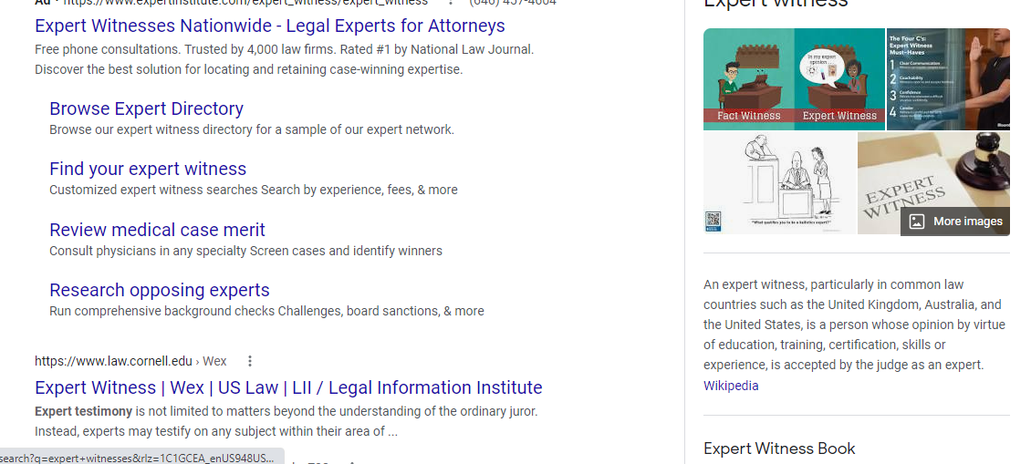

Slide 39
CHOOSING AN EXPERT
Google
Social media
READ ANY PUBLICATIONS
CONTACT OTHER ATTORNEYS AND ASK IF THEY ARE FAMILIAR WITH THE EXPERT
CONTACT PROFESSIONAL ORGANIZATIONS SUCH AS NDAA, ABA, ETC
WESTLAW OR LEXIS SEARCH
OBTAIN TRANSCRIPTS IF AVAILABLE
HAS YOUR EXPERT EVER BEEN EXCLUDED

Slide 40
VETTING AN EXPERT
Fact check CV/RESUME
CHECK FOR CRIMINAL HISTORY/ DISCIPLINARY VIOLATIONS
TALK TO THE EXPERT – HOW MANY TIMES HAVE THEY TESTIFIED, MEMBERSHIPS IN PROFESSIONAL ORGANIZATIONS
EDUCATE YOURSELF
ASK YOURSELF WHAT YOU WOULD EXPECT OF AN EXPERT IN THAT FIELD
DOES YOUR EXPERT HAVE FINANCIAL INTERESTS-CLASS ACTION EXAMPLE
COST

Slide 41
PRETRIAL PREPERATION
DISCLOSE YOUR EXPERT AND NECESSARY DISCOVERY
DECIDE IF YOU WISH TO CHALLENGE YOUR OPPONENT’S EXPERT
PROVIDE YOUR EXPERT WITH NECESSARY DOCUMENTS
PREPARE WITH YOUR EXPERT, EXPLAIN MAIN POINTS, EXPLAIN TRIAL PROCESS
DON’T BORE THE JURY
DEMONSTRATIVE EXHIBITS
REMEMBER TO PREPARE THEM FOR CROSS EXAMINATION
ASK THEM IF THEY HAVE ANYTHING TO ADD
DAUBERT HEARING

Slide 42
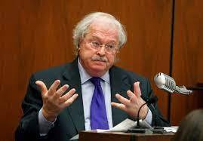
NAME THAT EXPERT…

Slide 43
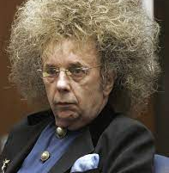
DR. MICHEAL BADEN
People v. Spector

Slide 44
Q and As?

Slide 45
THANK YOU!

