Slide 1
Trials In The COVID Age
Presented February 16, 2021
Wyandotte County Bar Association
Jennifer Tatum

Slide 2
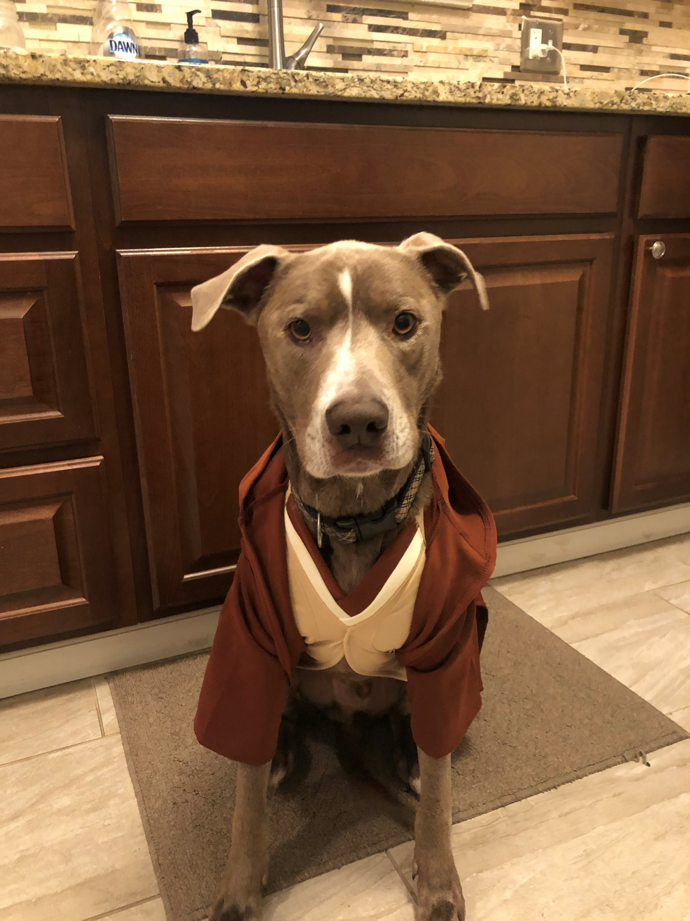
There is no ignorance, there is knowledge. There is no passion, there is serenity. There is no chaos, there is harmony. There is no death, there is the Force.

Slide 3
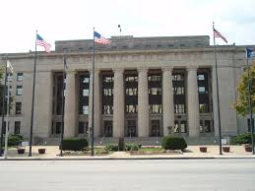
29th JUDICIAL DISTRICT, WYANDOTTE COUNTY, KANSAS
Currently in Phase 3 of Ad Astra Reopening Plan (dated May 28,20), See wycokck.org.
See also Kansas Supreme Court Administrative Orders 2020-PR-48 and 2020-PR-54.
Allows dockets with limited in court appearances and evidentiary hearings at Court’s discretion.
Also references Admin. Order 2020-055 and 56, which authorizes virtual hearings.

Slide 4
29th JUDICIAL DISTRICT, WYANDOTTE COUNTY, KANSAS
The order directs that all hearings should be conducted remotely, if possible. It prohibits most in-person proceedings that require more than 10 people in a courtroom, and it requires that all persons in a courtroom be at least 6 feet apart.
The order allows jury trials to proceed if it's required to preserve a person's constitutional right to a speedy trial and the court has presented its departmental justice a plan that:
allows for voir dire, or jury selection, involving jury panels numbering no more than 12 at a time;
uses a location that provides for social distancing;
designates how and where sidebar conversations will occur;
specifies how exhibits will be handled between attorneys, court staff, and jurors;
provides a videostream of the proceedings for public viewing, if necessary; and
specifies how the jury will be managed to meet social distancing requirements, addresses jurors' ability to hear and see witnesses and exhibits, and identifies where jurors will deliberate, including how they will leave for and return from deliberation.

Slide 5
KANSAS SUPREME COURT (kscourts.org)
Admin. Order 2021-PR-009 (Jan. 26, 2021). Senate Bill 102 allows Court to issue an Order to extend or suspend and deadlines of time limitations established by statute. Such has been done through March 31,2021. Several other Orders remain in effect including 2020-PR-130, 113, 107, and 101.

Slide 6
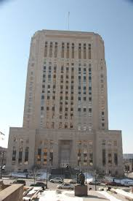
16TH CIRCUIT COURT OF JACKSON COUNTY, MISSOURI
HEAD JUDGE J. DALE YOUNGS
CURRENT ORDER: 02/15/21, See 16thcircuit.org
EASTERN JACKSON COUNTY: PHASE 3
DOWNTOWN JACKSON COUNTY: PHASE 3:
FAMILY COURTS: PHASE 3
MUNICIPAL COURTS: PHASE 1-3 (minimizing physical presence of persons in Court buildings is preferred)

Slide 7
PHASES-SUPREME COURT DEFINED
Phase Zero
Most in-person proceedings suspended
Access to courthouse greatly limited
Phase One
Critical proceedings may resume
Courtrooms and other public spaces limited to no more than 10 people if possible
Phase Two
Additional proceedings may resume
Courtrooms and other public spaces limited to no more than 25 people if possible
Phase Three
Resume proceedings in compliance with local social distancing and occupancy limit protocols
Courtrooms and other public spaces open in accord with social distancing protocols

Slide 8
16TH CIRCUIT COURT OF JACKSON COUNTY, MISSOURI
Missouri Supreme Court Order issued July 24, 2020 controls, which allows a presiding Judge to change the operating phase in his/her respective circuit. See courts.mo.gov
Judges are encouraged to utilize all available technologies to limit in person courtroom appearances that are prohibited by constitution and state statutes
The Court must submit a plan to the Missouri Supreme Court that complies with the Supreme Court Order
Municipal Courts may have in person proceedings in “extraordinary and urgent situations.”
Inmates will NOT be transported except or trial proceedings or for a hearing where presence is constitutionally required
In person hearings on Full Orders of Protection

Slide 9
16TH CIRCUIT COURT OF JACKSON COUNTY, MISSOURI
No jury trials through February 28, 2021
Intention is to resume jury trials in March 2021
Jackson County engaged in approximately six criminal jury trials in the Independence Courthouse in October and November 2020, until COVID cases returned both courthouses to Phase 1.

Slide 10
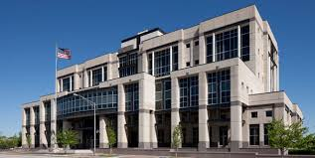
U.S. COURT FOR THE DISTRICT OF KANSAS
CURRENT ORDER: Administrative Order 2021-2, all in person civil and criminal trials suspended until March 31, 2021 (dated 2/2/01). See ksd.uscourts.gov
Emergency in person hearings may be conducted if deemed necessary
Continuances excluded from speedy trial act 18 U.S.C. 3161(h)(7)(A)
Approximately 5 in person trials (all civil) held in August/September 2020 before trials suspended again
Can conduct virtual trials in some cases

Slide 11
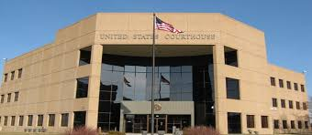
U.S. COURT FOR WESTERN DISTRICT OF MISSOURI
CURRENT ORDER: No in person trial proceedings until May 3, 2021 (dated 2/1/21).See mow.uscourts.gov
Note that 18 U.S.C. Section 3161(h)(7)(A) excludes continuance from “speedy trial” time
Ordinary criminal and civil matters may proceed in person or via video, Court’s discretion
Bench trials (civil and criminal) may be held via video conference at Court’s discretion
Bankruptcy hearings will be held virtually but can be in person at Court’s discretion

Slide 12
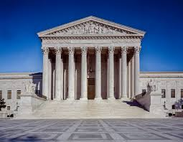
SUPREME COURT OF THE UNITED STATES
January 22, 2021 press release provides that all oral arguments scheduled for February will be by telephone conference
All arguments have been virtual since March 2020

Slide 13
TO CHECK OTHER STATES:
https://www.justia.com/covid-19/50-state-covid-19-resources/court-operations-during-covid-19-50-state-resources/

Slide 14
BEST PRACTICES
Identification of exhibits:
During COVID try to work with other party to stipulate to exhibits in advance. Allow opposing counsel to view any exhibits in advance. There is no reason for anyone to examine for the first time at trial. Speak to your presiding Judge with counsel present regarding expectations. If not possible to stipulate, ensure you can meet safely with witness in person or virtually (depending on exhibit), prior to trial to make sure foundation can be provided smoothly.
Virtually- pictures, maps, demonstrative exhibits, documents, records, etc. foundation should be able to be provided virtually prior to trial.
Non-virtual- physical objects will likely need to be examined in person. Be safe with masks, sanitizer, and social distancing. As few as people should be present as necessary. I.e. eliminate clients, family members, interns, other coworkers if possible. Do this prior to trial to avoid unnecessary exposure.
Mark prior to trial.

Slide 15
BEST PRACTICES
Identification of exhibits:
Early exchange and cooperation between counsel is preferred. Exchange exhibit and witness lists. Obstinacy seems especially unnecessary during COVID.
If testifying virtually, ensure that you have engaged in open discovery prior. Provide the exhibit to your witness. Mark the exhibit and arrange to have it displayed virtually through an online platform. Many court reporters in the Metro area are already doing this. Have a physical copy of the exhibit available to display if need be. Master the screen share/ the platform you will be using. You are NOT a cat.
If in person—check with presiding Judge and local rules regarding COVID restrictions prior to trial. It may be necessary to approach the witness if precautions are in place, but it may also be possible to display the exhibit at a distance or provide it in a notebook in a sleeve that can be sanitized and place in front of the witness so no approach is necessary. If opposing counsel needs to examine, hand it to them with proper protective wear.

Slide 16
BEST PRACTICES
Prior to Trial:
What does Court or local rules require? Face mask, face shield or clear mask for witnesses/ attorneys?
Where are witnesses allowed to congregate?
How many are allowed in the courtroom—including office staff, court staff, clients and their friends/family?
Will Court provide equipment or must you bring your own?
Sanitizing during proceedings?

Slide 17
BEST PRACTICES
Presentation of exhibits to jury:
Check with presiding Judge and opposing counsel prior . Does a delay in proceedings really help anyone during a pandemic?
Options include providing a binder for Judge/Jury/opposing counsel with sleeves that can be sanitized. A better option could be providing exhibits digitally via a thumb drive and/or disc. In that case, you must ensure that the Judge and Jurors have the means via computer or television to view the same.
Provide all necessary parties with sanitizer, latex gloves, masks, and anything else that may be needed for safety when handling exhibits and any necessary equipment.
Ensure that Judge/ Jury/ Witness can view the exhibits in advance. This may mean through a combination of a means of projection and/or personal binders.

Slide 18
BEST PRACTICES
Transferring Exhibits to Court/Playing Videos:
Prior to trial, be clear on what Court wants. Options are digital exhibits, personalized notebooks for Witness/ Parties/ Judge/ Court Reporter/ Jurors, or some other possibility.
Check with Court regarding any pictures/videos/ other exhibits that need to be displayed. Whose equipment will be used. Some Courts have very nice equipment, including personal screens for jurors…others do not. Prior to display ensure everyone can see! Including Judge/ Witness/ Jurors/ all involved parties.

Slide 19
BEST PRACTICES
Witness Scheduling:
Be aware of Court plan and local rules in advance for as how to get witnesses in and out of the courtroom. They can wait nearby, you can use office personnel and use email/texts to communicate if Court will allow/ if proceedings are transmitted virtually they can watch and be ready.
In between witnesses, stand needs to be sanitized, likely by Bailiff.
Microphone or stand for counsel may also need to be sanitized between direct and cross.
Courtroom may need to be sanitized during breaks.
Air filtration systems may be used.
Note: also consider best practices for any office staff/ clients/ other observers who wish to be present.

Slide 20
BEST PRACTICES
Virtual Hearings:
Make sure you are in calm and quiet area. Be professional. You are going to Court!
Be familiar with using the platform. Ask Court and opposing counsel regarding use of cameras and when.
Court should be able to mute and video of all parties, as well as let parties in and out of “room.” (make them aware if witness rule has been invoked).
Backgrounds?
Kansas Supreme Courts have practice runs. You should ask for one from your local Court.
Make sure you have trustworthy device. Likely a laptop is best. Go horizontal if you use phone or tablet.
Standing or sitting? Sitting better for a microphone.
Use your IT resources if your office has them.
Watch that feedback.
If you have interested parties participating online, go through protocol with them as well.
In criminal cases, victims have a right to participate. Make sure this happens.
Identification—may have to be creative but can be done.

Slide 21
BEST PRACTICES
Sidebars:
Again…talk to Court prior. Will white noise be used? Will jurors be excused? Much more impetus in COVID to be timely in your Motions and any evidentiary arguments/objections. Judge will appreciate it/ Jurors will appreciate it.
Virtual sidebars- should be able to use some sort of break out room.
In person side-bars- in chambers or in another courtoom?

Slide 22
BEST PRACTICES
Jury Issues:
Questionnaires: explain process and safety measures. Allow process to opt out and to report exposure during and subsequent to jury service.
Virtual selection, provide tablets?
Seating: Counsel and Jurors, limit number of jurors present. Do you have several smaller panels?
Limitation of voir dire?
Materials: Masks, sanitizer, pens, notepads, etc. What will be provided.
Elevator/ Stair Use.

Slide 23
BEST PRACTICES
Jury Issues:
Jury Room/ Food/ Water.
Jury seating in courtroom.
IT considerations.
Air filtration system?
Streaming?
If public, seating of spectators
Limit number of trials per week
Divide divisions to limit courthouse traffic?
Supply bags for jurors
Jury instructions?

Slide 24
BEST PRACTICES- JACK. CO. VOIR DIRE
We will prioritize 3-5ish cases each week for each courthouse.
We will summon one group of prospective jurors in the morning each day and one group in the afternoon each day (for both KC and Independence), based on the following schedule.
The process below will be repeated 2 times each day. Social distancing will be maintained. We will be summoning smaller groups (less than the capacity of the jury assembly room in each location) to facilitate prompt voir dire and allow both the morning and afternoon groups to be part of voir dire.

Slide 25
BEST PRACTICES- JACK. CO. VOIR DIRE
8:00 - Scheduled reporting time for juror group 1. Prospective jurors will be seated and juror qualification begins.
8:00 - 8:35 – Qualification of juror group 1. At the conclusion of this process, any disqualified juror will be released.
8:15 - 8:30 – Jury lists and BioForms will be available to Court as soon as possible (and the Court will provide this information to the attorneys). Prospective jurors are seated when they arrive. They are given numbers and will remain in their assigned seat during qualification and voir dire. You will be emailed a list that identifies all prospective jurors and their respective numbers – the Court will provide this to attorneys. No new list will be provided after any juror is disqualified – you will simply strike that person from your list – the remaining venire panel will not be re-numbered. This list will be used by the court and the attorneys for voir dire.
8:45 --9:00 – Voir dire commences in jury assembly room of group 1 (should start no later than 9:00). All venire panel members will remain seated in their same, assigned seat.
12:00 – Voir dire of group 1 must be completed (sooner if possible), including challenges/strikes for cause for group 1 (remember this is a smaller group so 3 hours should be adequate time). This group will be sent home after voir dire. The jury assembly room must be vacated to allow for it to be sanitized before juror group 2 is seated. There will be time before qualifying group 2 for lunch and possibly address pre-trial matters in your courtroom.

Slide 26
BEST PRACTICES- JACK. CO. VOIR DIRE
Room is cleaned and sanitized and process repeats in the afternoon.

Slide 27
RESOURCES
https://www.uscourts.gov/sites/default/files/combined_jury_trial_post_covid_doc_6.10.20.pdf (Federal Judges/ Covid-19 Judicial Task Force dated June 2020)
https://www.kscourts.org/KSCourts/media/KsCourts/court%20administration/Juries/Jury-Trial-Task-Force-full-report-final2.pdf (Kansas Courts Ad Hoc Jury Task Force Report dated July 2020)

Slide 28
REAL LIFE COVID TRIAL EXPERIENCES
SEPTEMBER 2020 CIVIL JURY TRIAL
U.S. COURT FOR THE DISTRICT OF KANSAS
JUDGE VRATIL PRESIDING

Slide 29
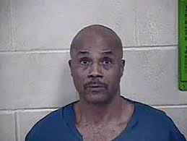
REAL LIFE COVID TRIAL EXPERIENCES
DECEMBER 2020 BENCH TRIAL
STATE OF MISSOURI v. KEVIN HURLEY
JUDGE YOUNGS PRESIDING

Slide 30
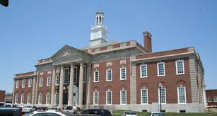
REAL LIFE COVID TRIAL EXPERIENCES
NOVEMBER 2020 JURY TRIAL
STATE OF MISSOURI v. THEODIST LEWIS
JUDGE YOUNGS PRESIDING
TRIED IN INDEPENDENCE, MO
GUEST SPEAKER: JORDAN BERGUS, SENIOR ATTORNEY, ATF, KANSAS CITY FIELD DIVISION

Slide 31
REAL LIFE COVID TRIAL EXPERIENCES
ANYONE ELSE?

Slide 32
QUESTIONS AND ANSWERS
Thank you for this opportunity. Hope it was helpful.
Jennifer Tatum
Violent Crimes Unit
Assistant Prosecuting Attorney
Jackson County Prosecutor's Office
415 E. 12th Street, Floor 7M
Kansas City, MO 64106
Ph: (816) 881-3628
Fax: (816) 881-3821
jtatum@jacksongov.org

