Slide 1
COVID-19 Effects on Workers’ Compensation, General Liability and Employment Law

Slide 2
Workers’ Compensation

Slide 3
SPECIAL ORDERS: MISSOURI
Rebuttable Presumption:
CSR 50-5.005:
  If first responder contracts COVID-19, they have a rebuttable presumption that they became infected in the line of duty
    Employer can defend/deny claim if they can prove that first responder’s exposure was not in line of duty
  Effective April 22, 2020 to February 21, 2021

Slide 4
COMPENSABILITY OF OCCUPATIONAL DISEASES: MISSOURI
Occupational diseases - identifiable disease arising with or without human fault out of and in the course of the employment. Section 287.067
  Ordinary diseases of life to which the general public is exposed outside of the employment are not compensable (except where the disease follows as an incident of an occupational disease)
  Disease need not have been foreseen or expected but after its contraction it must appear to have had its origin in a risk connected with the employment and to have flowed from that source as a rational consequence
  Any employee who is exposed to and contracts any contagious or communicable disease arising out of and in the course of their employment is eligible for benefits as an occupational disease.

Slide 5
COMPENSABILITY OF OCCUPATIONAL
DISEASES: MISSOURI
Key question is “whether the job duties increased the employee’s risk of contracting the disease?”
  Healthcare workers
  Essential workers
  Employees working around large numbers of co-workers and not required to wear PPE

Slide 6
COMPENSABILITY OF OCCUPATIONAL
DISEASES: KANSAS
Occupational disease - disease arising out of and in the course of employment resulting from the nature of employment in which the employee was engaged under employer, and which was actually contracted for while so engaged. K.S.A. 44-5a01(b).
  Requires death or disablement
  Disease must result from nature of employment (a particular hazard of the disease, which is greater than the general risk and the risk of other occupations or trades, which distinguishes the employment from other occupations)
  Disease must have special risk that is connected with the particular type of employment and must have resulted from that source as a reasonable consequence of the risk
  Excludes: ordinary diseases of life and conditions to which the general public is or may be exposed outside of the particular employment, and hazards of diseases and conditions attending employment in general.

Slide 7
COMPENSABILITY OF OCCUPATIONAL DISEASES: KANSAS
Key question is “whether the nature of employment created a particular hazard of the disease?”
  Most at risk: healthcare workers & first responders
  Least at risk: general office employees or warehouse workers – difficult to be successful in an exposure claim as most of these occupations do not include a particular hazard of coronavirus to which the general public is not exposed

Slide 8
IS COVID-19 A COMPENSABLE CLAIM?
Prosecution of the claim
  Rebuttable presumption
  Link of contracting the disease to job duties
  More than a statistical possibility
  Does disease flow from the job?

Slide 9
IS COVID-19 A COMPENSABLE CLAIM?
Defense of the claim
  Consider consequences of denial of claim.
  Ordinary disease of life v. occupational disease
  Probability v. possibility of contracting the disease.
  Equal exposure outside of work
  Medical records
  Contact tracing
  Experts

Slide 10
VACCINATIONS AND SIDE EFFECTS
Consider consequence of work comp denial: civil liability.
Other employer considerations

Slide 11
VACCINATIONS AND SIDE EFFECTS
Is it compensable?
  Medical causation
  Mandatory v. Voluntary
  Provided by employer on site?
  Benefit to employer to have worker vaccinated?
  Required by CDC or other health guidelines?
  Equal exposure in non-employment life.

Slide 12
METHODS OF INVESTIGATING AND DEFENDING COVID-19 CLAIMS
Contact Tracing
Cross-Referencing Workers
Family and Friends with COVID
PPE used by workers
Experts
  Medical (Pulmonologists, Infectious Disease, Internists)
  Epidemiologists
  Statistics (likelihood of individual contracting disease from work v. outside of work)

Slide 13
DAMAGES
TTD:
  Missed time from work due to coronavirus
PPD:
  Concerns that some individuals may experience more serious and longer lasting health issues as a result of disease which suggests possibility of permanent disability benefits
    Specifically - long term respiratory and vascular conditions could raise PPD values
Death:
  Exposure for death benefits in cases where worker dies as result of the disease
Medical:
  Treatment of coronavirus symptoms

Slide 14
BUSINESS DECISIONS IN ACCEPTING OR DENYING CLAIM
Costs
Public Relations issues

Slide 15
Employment Law

Slide 16
NEW OSHA GUIDANCE
January 29th, OSHA released new guidance addressing mitigating and preventing the spread of COVID-19 in the workplace
This guidance is intended to inform employers in most workplace settings outside of healthcare
There are 8 key measures that are outlined in this new guidance
OSHA applies both federally and through state-run plans that are at least as effective as OSHA, meaning that it applies to most private sector employers and employees nationwide. OSHA defines an “employer” as “a person engaged in a business affecting commerce who has employees,” which is quite broad.

Slide 17
AM I AN EMPLOYER COVERED BY OSHA?
Am I private sector or public sector?
Private
Public
Yes, unless one of these exceptions applies
No. But are you Federal or State/Local?
Self-employed
State
Farms only employing immediate family
Federal
Industries where another federal agency regulates safety
Churches
No, but 22 states (Iowa) have adopted OSHA-approved plans that are at least as protective as OSHA. Five states (Illinois) have plans that cover public employees while private sector employees are still covered federally by OSHA
No, but federal agencies must have health and safety plans that meet the same standards as private employers under OSHA
Transportation (covered by DOT)
Mining
(covered by MSHA)

Slide 18
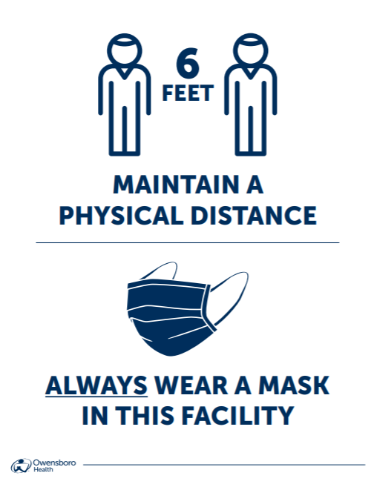
EMPHASIS ON PHYSICAL DISTANCING
Masks are NOT a replacement for physical distancing, but complementary
Physical distancing is a key protection in reducing and eliminating workplace exposures

Slide 19
COVID-19 PREVENTION PROGRAM
There are 16 elements to an effective COVID-19 Prevention Program
Assign a workplace coordinator
Complete a hazard assessment
Identify measures that will limit the spread
Consider protections for workers at a higher risk for severe illness
Establish an effective communication system
Educate and train workers on policies and procedures
Instruct workers who are infected or potentially infected to stay home and isolate
Minimize negative impact of quarantine on workers
Isolate workers who show symptoms at work
Perform enhanced cleaning/disinfecting after confirmed or suspected cases in facility
Provide guidance on screening/testing
Record & report COVID-19 infections and deaths
Implement protections from retaliation & set up anonymous system for workers to voice concerns
Make COVID-19 vaccine available at no cost
Don’t distinguish between vaccinated and unvaccinated workers
All other applicable OSHA Standards

Slide 20
ISOLATION
Isolating workers who have or likely have COVID-19
If workers have symptoms, they can return after:
    10 days since symptoms first appeared; and
    At least 24 hours with no fever without fever-reducing medicine; and
    Other symptoms of COVID-19 are improving
The ADA permits employers to require a doctor’s note from workers to verify that they are healthy and able to return to work
The CDC does not recommend use of antibody tests to determine which workers can work, as they are not very reliable

Slide 21
QUARANTINE
Quarantine workers who have been exposed to COVID-19
An exposure to COVID-19 includes:
    They were within 6 feet of someone with COVID-19 for 15 minutes or more
    They had direct physical contact with someone who has COVID-19
    They shared eating or drinking utensils with someone who has COVID-19
    Someone with COVID-19 sneezed or coughed on them
Quarantine for 14 days after the last contact with someone who has COVID-19
    Watch for COVID-19 symptoms
    Stay away from people who are at high risk for getting very sick from COVID-19

Slide 22
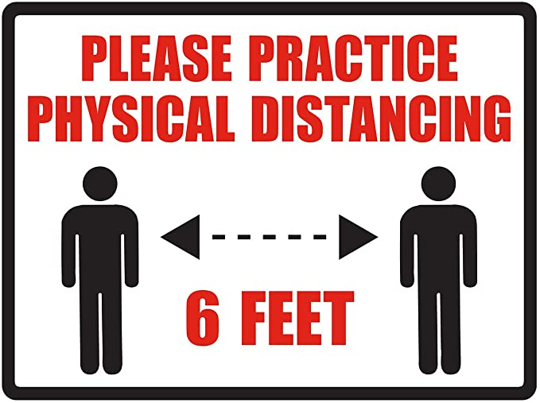
IMPLEMENT PHYSICAL DISTANCING IN
ALL COMMUNAL WORK AREAS
Limit the number of people in one place through telework, remote work, and/or flexible hours
Increase physical space between workers & customers and consider using visual cues to encourage individuals to stay 6 feet apart

Slide 23
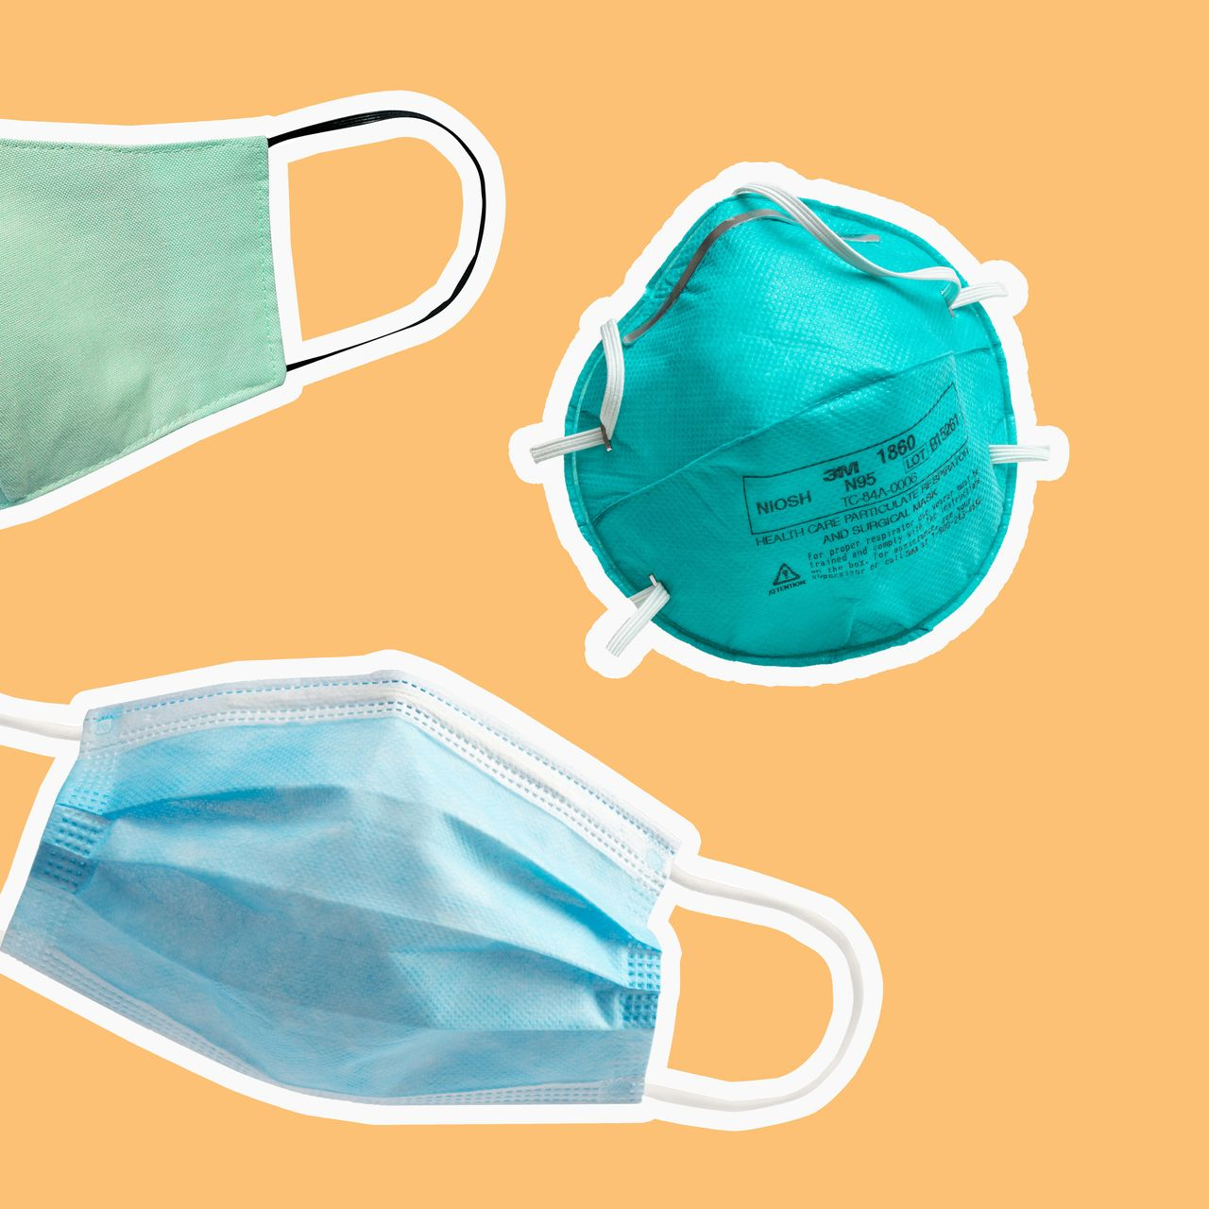
SUPPRESSING THE SPREAD USING
FACE COVERINGS
Employers provide all employees with face covering at no cost unless a respirator is required
Reasonable accommodations for those with disability
Require visitors and customers to wear a face covering unless under the age of 2 or actively consuming food/beverage

Slide 24
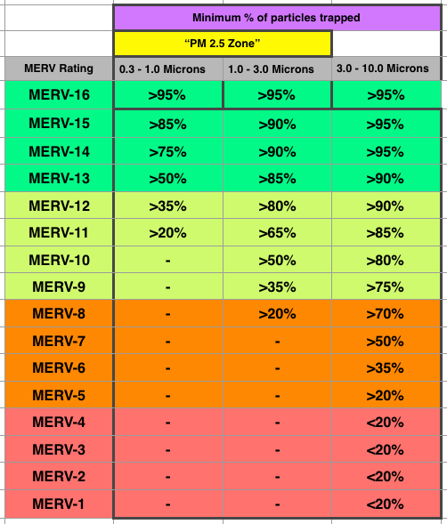
IMPROVING VENTILATION
Increase ventilation rates if possible
Disable demand-controlled ventilation
Improve central air filtration to the MERV-13
or highest compatible filter

Slide 25
USE PPE WHEN NECESSARY
When you cannot implement the previous measures to fully protect workers, OSHA requires employers to provide PPE to supplement other controls. This includes:
Determining what PPE is necessary
Providing PPE, including respirators, face shields, gloves, and protective gowns at no cost
Where PPE is not required under OSHA, some workers may have a right to PPE as a reasonable accommodation under the ADA

Slide 26
PROVIDE SUPPLIES NECESSARY FOR
GOOD HYGIENE
Tissues & no-touch trash cans
Soap and water or alcohol-based hand sanitizer that is at least 60% ethanol or 70% isopropanol
Provide workers time to wash hands or use hand sanitizer and inform workers that soap and water is preferred if hands are visibly dirty.

Slide 27
FAMILIES FIRST CORONAVIRUS
RESPONSE ACT
The Families First Coronavirus Response Act provides certain employers 100% reimbursement through tax credits to provide employees with paid sick leave or expanded family and medical leave for specified reasons related to COVID-19 through March 31, 2021
For more details on the FFCRA, please visit: https://mvplaw.com/families-first-coronavirus-response-act-signed-into-law/

Slide 28
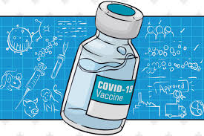
VACCINES & PREVENTIVE MEASURES
Your employee got the vaccine, now what?
Privacy considerations regarding vaccination status

Slide 29

THE POST-PANDEMIC WORKPLACE
How to handle a return to office
Procedure for recalling employees
Privacy regarding COVID-19 infections & vaccines
What steps must you continue to take to protect employees

Slide 30
General Liability

Slide 31
General Liability Risk for Exposure and Transmission
Personal Injury to a Customer/Guest/ Patron
Negligence and premises liability
A claim for negligence requires the injured party to prove:
  A duty was owed by defendant to plaintiff;
  Defendant breached that duty;
  The Breach of duty caused injury to plaintiff;
  Plaintiff thereby suffered damage

Slide 32
Potential Claims
Failure to properly clean or maintain the premises to prevent the presence of the coronavirus
Failing to take proper precautions after learning an employee was infected with COVID-19
Failing to take proper steps to limit or avoid transmission from other patrons or employees such as masks, social distancing, etc

Slide 33
Defenses
Causation
Open & obvious danger
Compliance with guidelines & industry standards
React to Known Infections
Retail Lability Waivers
Warning/Informational Signs

Slide 34
Scope of Potential Claims
Fear of contracting the virus
  Weissberger v. Princess Cruise Lines, Ltd.
Civil claims by employees
Claims by family & friends

Slide 35
OSHA Reportability
In May 2020, OSHA temporarily revised recordkeeping requirements
COVID-19 is a recordable illness which employers are responsible for recording if:
    it is a confirmed case,
    it otherwise falls in the recordable guidelines, and
    it is work related.

Slide 36
OSHA Inspections, Citations
& Complaints
Over 1,000 inspections are performed across the country, many resulting in citations. Many of these citations are for failure to report recordable injuries & illnesses and failure to provide respiratory protection.
Over 50,000 complaints have been raised to OSHA or state counterparts related to COVID-19.

Slide 37
Executive Order on Protecting
Worker Health & Safety
OSHA issued guidance on 1/29
Employers should implement COVID-19 Prevention Programs
Consideration of the necessity of emergency temporary standards, such as masks in the workplace, and issue standards by March 15
Focus OSHA enforcement on COVID-19 violations

Slide 38
Litigation Related to COVID-19
There are numerous types of lawsuits filed arising out of COVID-19 beyond claims about transmitting & contracting the disease.
Actions for cancelled services or memberships
Event cancellation
Price gouging
Products liability
PPP Loan Processing
Civil rights claims for stay at home orders, business closures, etc.
Litigation over essential vs. non-essential designation
Education request for refunds
Conditions of employment
Disability disputes under ADA & state law
Leaves of absence
Landlord/tenant disputes

Slide 39
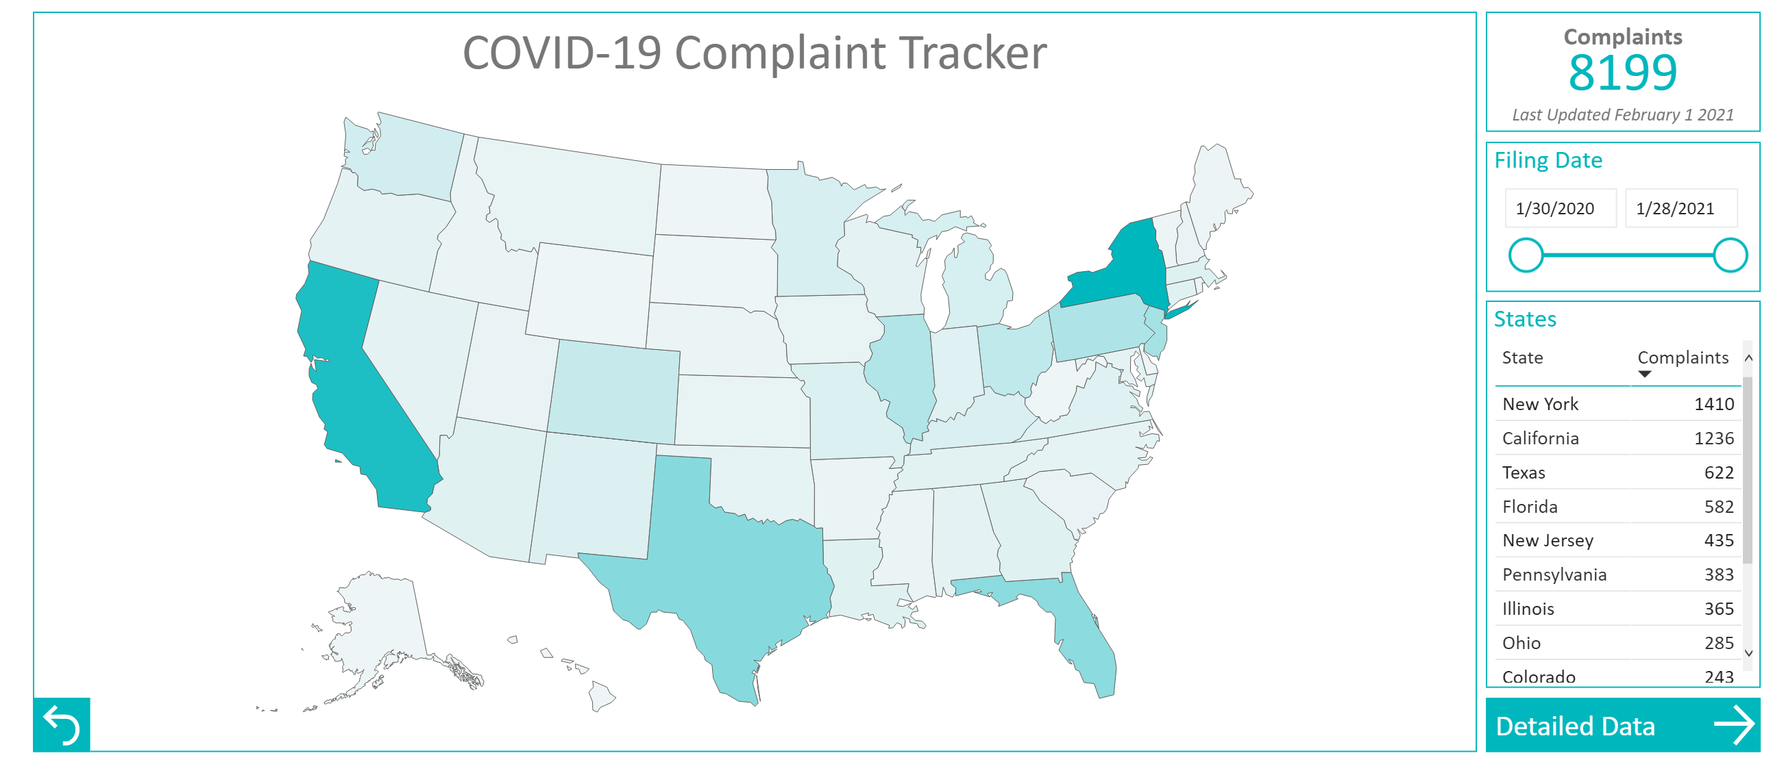
COVID-19 Complaint Tracker
https://www.huntonak.com/en/covid-19-tracker.html

Slide 40
Protective Legislation
Federal Legislation
Senate Bill 4317 – The Safe to Work Act
State Legislation
At least 16 states have adopted some level of immunity or defense legislation for COVID-19 related claims through state executive orders or state legislation.
  Includes Kansas, Arkansas, Iowa, Oklahoma

Slide 41
Kansas
COVID-19 Response and Reopening for Business Liability Protection Act
Business has immunity from liability in a civil action arising out of exposure or potential exposure to COVID “if such person was acting pursuant to and in substantial compliance with public health directives applicable to the activity giving rise to the cause of action when the cause of action accrued”. Retroactive immunity from 3/12/20 to 1/26/21.

Slide 42
Other States
Some are limited to “essential businesses”
Most exclude gross negligence, reckless misconduct
Most apply retroactively to beginning of the pandemic
Most are limited to COVID-19 claims

Slide 43
Potential Issues
Authority as it relates to executive orders
Lack of clear definitions
Uncertain scope and applicability
Retroactive application

Slide 44
Public Readiness & Emergency
Preparedness Act (PREP)
Secretary of Health and Human Services issued declaration on March 10th, 2020 invoking liability protections under PREP.
Framework for immunity from claims from the manufacture, development, distribution, administration and use of medical countermeasure during a public health emergency and also creates no fault system to compensate victims.

Slide 45
Insurance Coverage Issues
Coverage for Liability Risk
CG 00 01 04 13 – CGL Coverage Form
Provides coverage for damages for bodily injury or property damage resulting from an occurrence subject to all other police terms, conditions and exclusions.

Slide 46
Bodily Injury
Bodily Injury means bodily injury, sickness or disease sustained by a person, including death resulting from any of these

Slide 47
Property Damage
Physical injury to tangible property, including the resulting loss of use of that property. All such loss of use shall be deemed to occur at the time of the physical injury that caused it; or
Loss of use of tangible property that is not physically injured. All such loss of use shall be deemed to occur at the time of the “occurrence” that caused it.
Occurrence means an accident, including continuous or repeated exposure to substantially the same general harmful conditions.

Slide 48
Exclusions
Expected or intended injury
Pollution exclusion
Employers Liability Exclusion
Communicable disease exclusionary endorsement

Slide 49
Business Interruption Insurance
“Exclusion of Loss Due to Virus or Bacteria” – Virus Exclusion from ISO BP 06 01 01 07
WE WILL NOT PAY FOR LOSS OF DAMAGE CAUSED BY OR RESULTING FROM ANY VIRUS, BACTERIUM OR OTHER MICROORGANISM THAT INDUCES OR IS CAPABLE OF INDUCING PHYSCIAL DISTRESS, ILLNESS OR DISEASE
Insurance Services Offices, Inc. (ISO) adopted this form in response to the SARS outbreak

Slide 50
All Risk Policy
Issue is “direct physical loss”
Studio 417 v. Cincinnati Insurance, Co.
North State Deli, LLC v. Cincinnati Insurance, Co.

